Slide 1
Performance Measurement in GEF
Neeraj Kumar Negi
Senior Evaluation Officer
GEF Independent Evaluation Office
March 11th 2015

Slide 2
GEF
The Global Environment Facility (GEF) is a partnership for international cooperation to address global environmental issues.
  Established in 1991
  183 member countries
  $13.5 billion in grants for 4000 projects

Slide 3
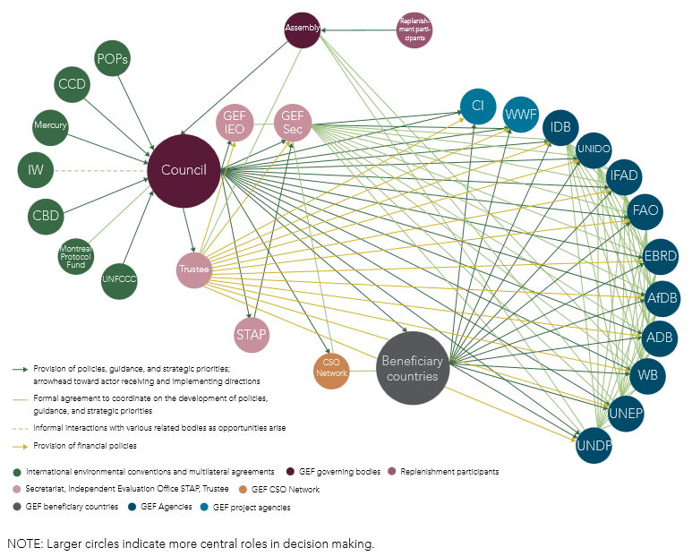
The GEF Network
Two more agencies – IUCN and DBSA have been added to the partnership

Slide 4
GEF IEO
GEF Independent Evaluation Office (GEF IEO)
  Established in 1996 as M&E Unit within GEF Secretariat
  Independent of the GEF Secretariat in 2003
Mission: to enhance global environmental benefits through excellence, independence, and partnership in monitoring and evaluation.
Objectives: to ensure accountability and learning
The GEF IEO has the central role of ensuring the independent evaluation function within the GEF.
  Sets minimum requirements
  Ensures oversight of the quality of M&E systems at program and project levels
  Shares evaluative evidence within the GEF

Slide 5
GEF IEO within the context of GEF Partnership
GEF IEO works in collaboration with the GEF Agencies
  Especially their evaluation offices
  Agencies already have M&E systems in place
  Ensuring uniformity is difficult
  Focus on minimum requirements
  UNEG and ECG standards and norms

Slide 6
Performance Evaluations
Performance evaluations in GEF context
  Provide feedback on the quality of the GEF portfolio, GEF policies and processes, and M&E. They may also assess efficiency and effectiveness of GEF supported activities and processes in delivering the expected outputs and outcomes.
  Give more attention to efficiency and accountability
  Focus on providing real time feedback
  Important for the Council and for other stakeholders in the GEF partnership
Examples
  Annual Performance Report – Results of completed GEF projects, quality of terminal evaluations, management action record, etc.
  Evaluations on GEF policies and procedures: activity cycle; STAR; etc.
  Evaluation of performance of GEF Programs and partnerships: National Portfolio Formulation Exercise; Expansion of GEF partnership; Small Grants Program, etc.

Slide 7
What gets measured?
Conversion of inputs into outputs/outcomes by GEF activities vis-à-vis expectations
Project results – outputs and outcomes; project implementation and execution; co-financing, etc.
Sustainability of the achievements of the GEF activities
Risks to sustainability of outcomes; progress to impact
Compliance with the GEF policies and procedures
Project cycle time lags, and GEF response time standards; minimum requirements on Project M&E; Environmental and social safeguards
Quality of systems and activities
Project at risk systems of agencies; project design and M&E systems
Management action on Council decisions
Quality of Management action on Council decisions

Slide 8
How is it measured?
Use of rating scales
  Outcomes and sustainability
  Implementation and execution
  Quality of M&E
  Quality of terminal evaluations
  Management Action on Council decisions
Categories – ordering of categories based on desirability
Ratios – co-financing
Time lags – activity cycle

Slide 9
Effects
Utility of performance measurement and reporting is widely accepted
Major contributions
  Terminal evaluations
  Supervision by implementing agencies
  Improvements in GEF’s resource allocation approach
  GEF activity cycle
Better understanding of causal relationships

Slide 10
Uncovering Performance Trends
Much of the regular reporting on performance takes place through Annual Performance Report (APR)
First APR (APR2004) was presented in 2005
  Since then nine more APRs have been presented (APR2013 bring the last one)
Cumulative data available through PMIS; work undertaken for APR, and other special efforts
  Medium to long term data is now available on several parameters
  It is now possible to track long term changes

Slide 11
Time taken for GEF full size projects – CEO Endorsement to Project Start

Slide 12
Aggregate Amount Requested from GEF through project proposals that are in different stages of preparation

Slide 13
Difficulties in assessing trends
Although plotting trends is possible it is not as straight forward for most of the parameters
  Policies: level of compliance may remain the same but there may be changes in the underlying requirements
  Where performance is compared vis-à-vis expectations (project outcomes etc.) it is difficult to assess trends as underlying expectations change
  Often the changes in performance due to factors that are of interest may be very small compared to the factors that introduce noise in the data

Slide 14
Examples of Performance Evaluations

Slide 16
To summarize
Performance measurement is important within GEF partnership
Several key dimensions of performance are being measured, tracked and being reported on
As datasets become richer trends may be analyzed, however, this also presents its own challenges.

