Slide 1

UNEG EPE - Strengthening decentralized evaluation functions
Messay Tassew, Evaluation Specialist
UN Women Independent Evaluation Office
New York
March 11, 2015

Slide 2
Architecture of decentralized evaluations
Executive Board
Independent Evaluation Office (IEO)
Regional Offices (ROs)
Country Offices (COs)
Civil Societies
Governments
HQ divisions
Executive Director
Beneficiaries
Reporting
Oversight
&
Feedback
Cooperate evaluation
Technical
+ Capacity
Decentralized evaluation

Slide 3
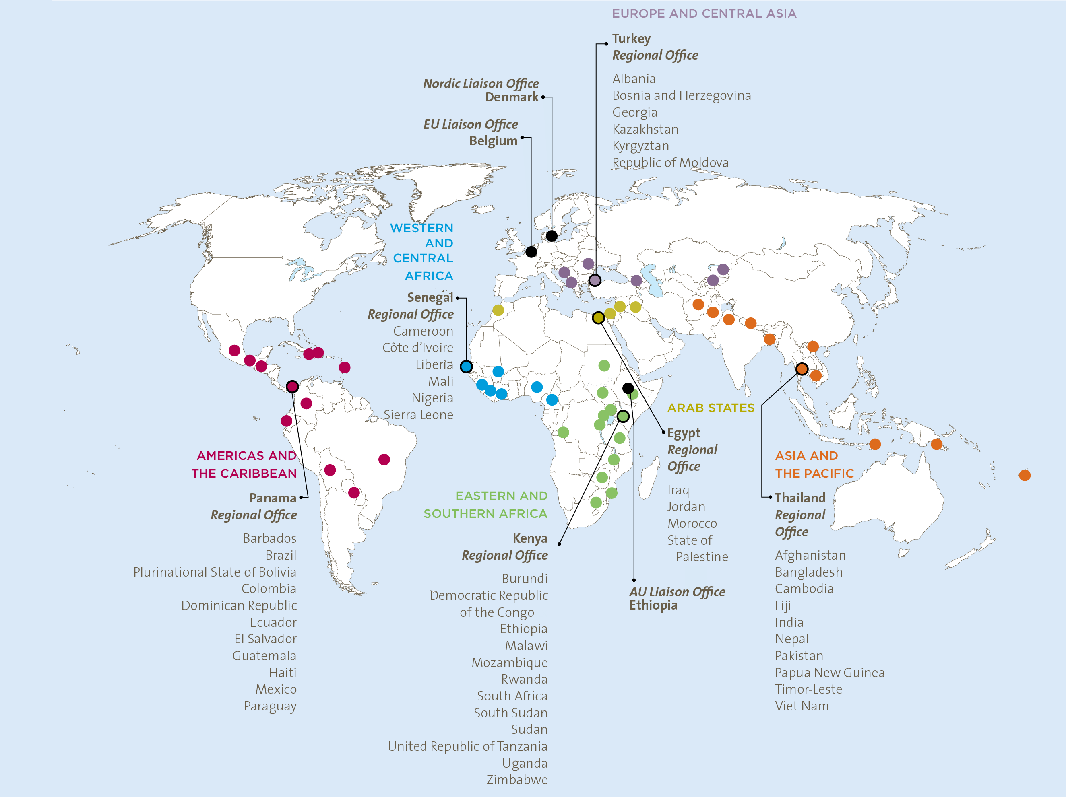
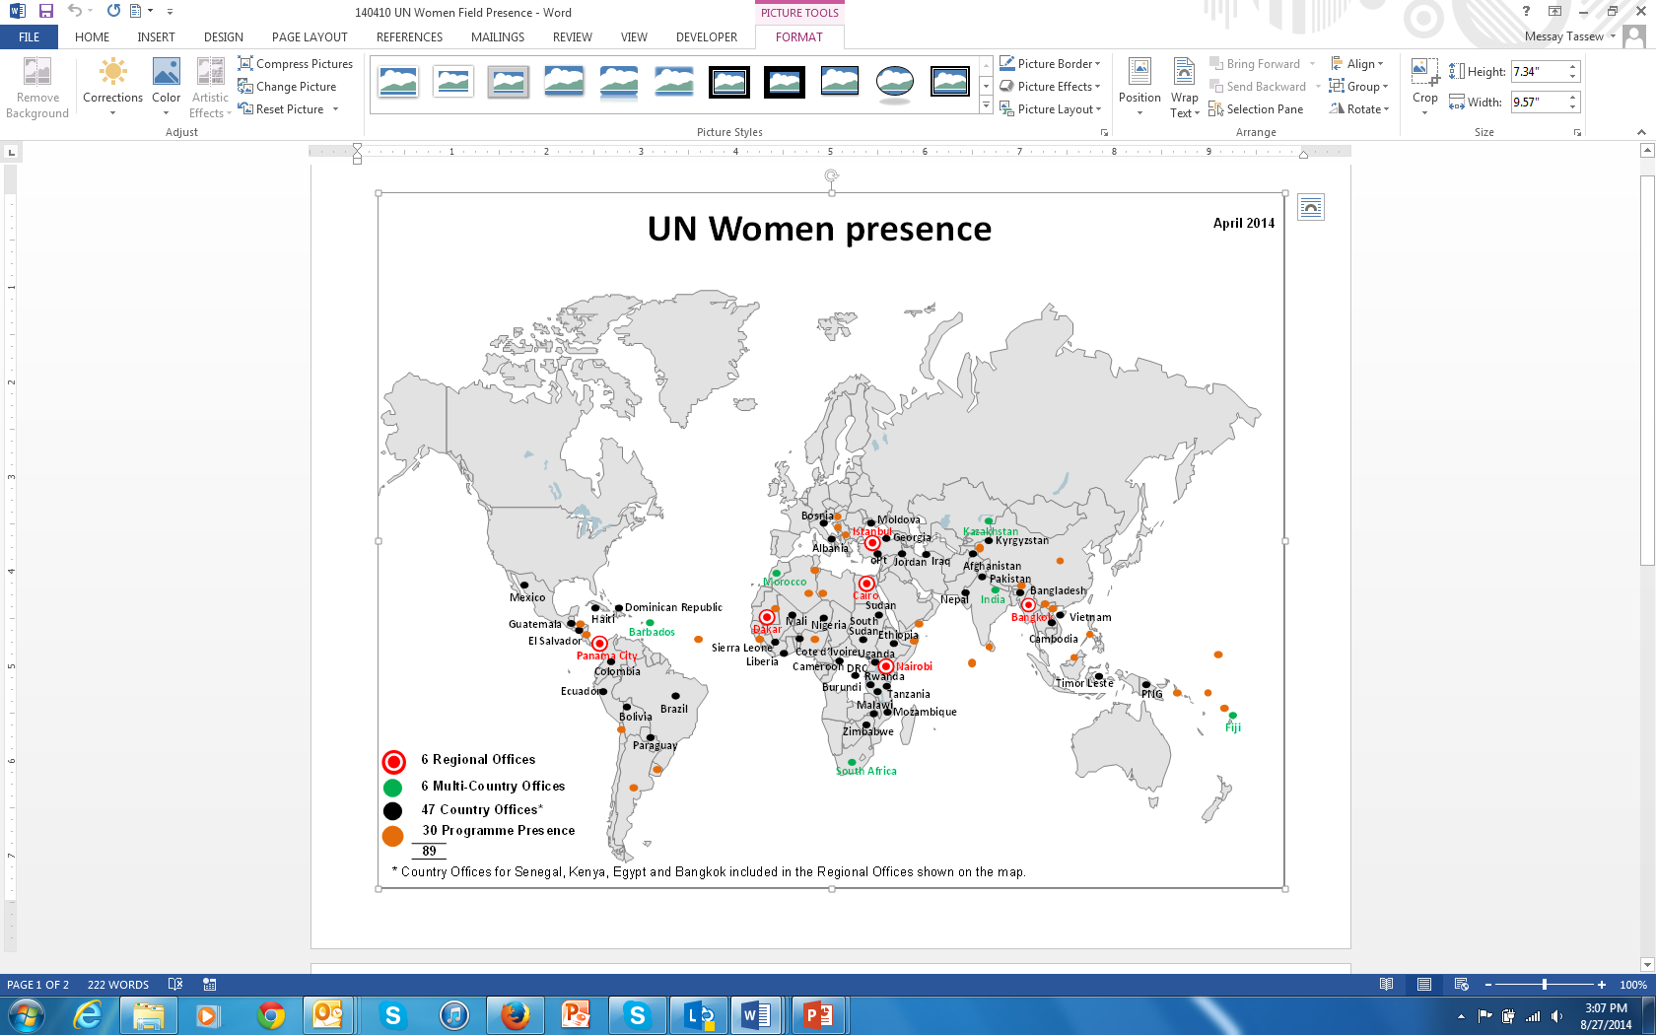

Decentralized Evaluations
Over 90% evaluations are decentralized
Commissioned by ROs/MCOs and COs

Slide 4
Decentralized Evaluation Function
Learning and accountability;
Regional Evaluation Strategies;
Costed decentralized plans approved with strategic notes;
Regional Evaluation Specialists in each of the regional offices
M&E Focal Points and Officers
Global Accountability and Tracking of Evaluation Use (GATE)
Global Evaluation Report Analysis and Assessment System (GERAAS)
Global Evaluation Oversight System (GEOS)

Slide 5
Roles and Responsibilities for Decentralized Evaluation
Evaluation manager
Regional Evaluation Specialist
Prepares ToRs, select external evaluator(s) together with RES, ensures participation, circulates draft and final report and ensures follow up
Provides oversight and quality assurance support (ToRs, consultant selection, inception, draft and final reports, tracks evaluation MR, member of EMG + Co-approval role for CPEs
External evaluation consultant
IEO
Oversees adherence to UN Women policy, provides guidance and tools, assesses quality of final products and provides feedback, reports performance to SMT and Ex. Board
Conducts and leads
evaluation, prepares evaluation report

Slide 6
What is the Unique Role of Regional Evaluation Specialists?
All Regional offices have a dedicated Regional Evaluation Specialists
RES report directly to the IEO director
No involvement in project design, formulation, implementation or monitoring except on evaluability assessment and integration of lessons in new programmes
Provide quality assurance throughout the evaluation process
  New KPI - ensure standardized approach and improved compliance
  New KPI – professionalization of evaluation function – e-learning course and coaching

Slide 7
Advantages
RES external to programme (impartiality and credibility)
Continuous capacity development required – M&E focal points not officers at the field level
Provide direct support to COs and partners: Oversight, quality assurance and capacity development
UNEG peer review – positive practice to enhance quality and impartiality
Improved quality - overall 40% V. Good and 95% satisfactory and above
Better communication, dissemination, and use – MR uptake reached 83% + reports submitted to GATE reached 100%
More role for RES – co-management and approval of final CPE products
Limited resources

Slide 8
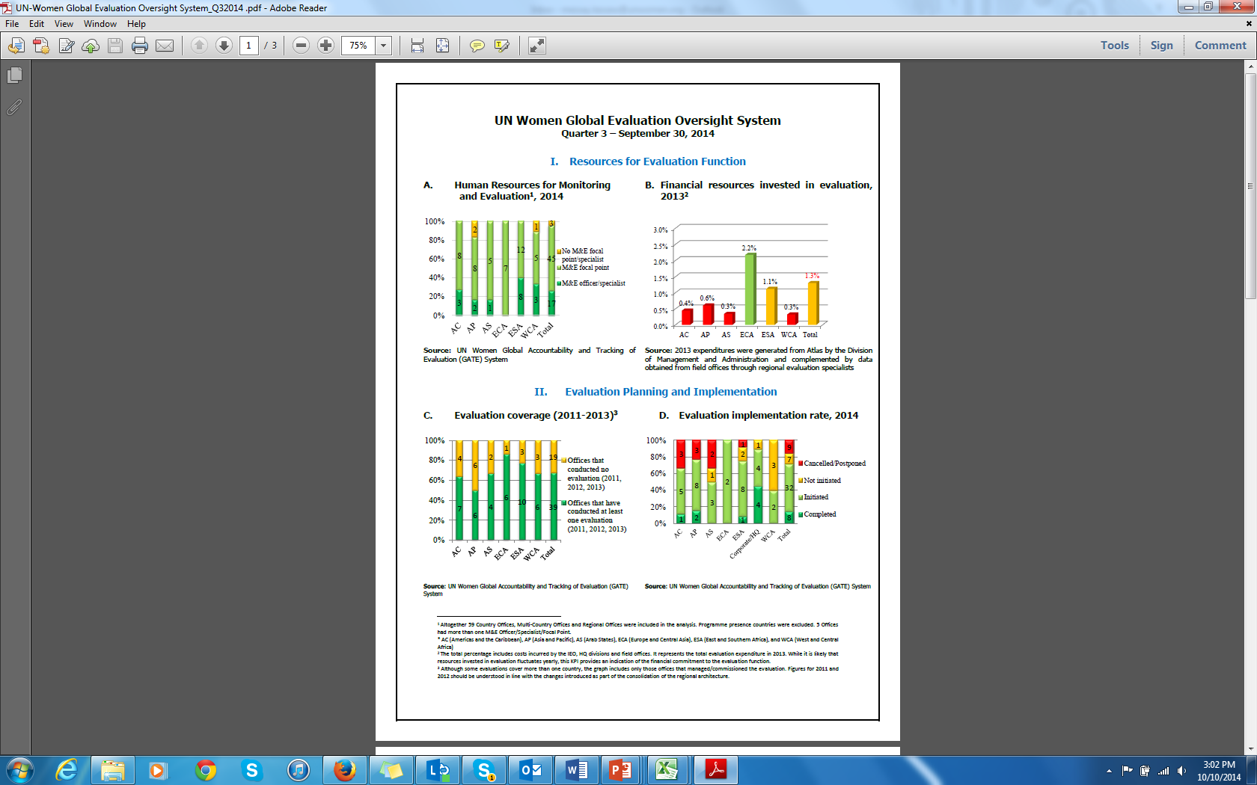
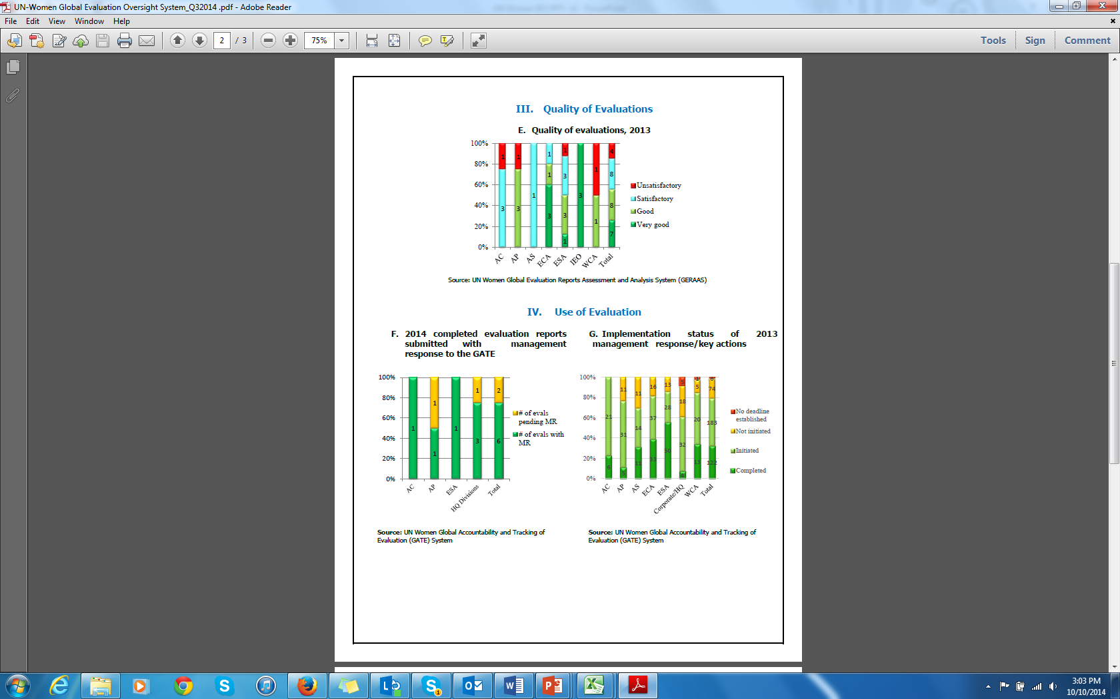
Systems to support Decentralized Evaluation Function
Global Evaluation Oversight System (GEOS)
Dashboard with seven evaluation key performance indicators
Build awareness and sustain action on evaluation function among senior management

Slide 9
GEOS Targets

Slide 10
Advantages of GEOS
Dashboard presented to the SMT bi-annually
Garnered the attention of the SMT – evaluation featured in Annual Regional Retreats, increased leadership by RDs,
Increased allocation of human and financial resources, quality of evaluations, increased use through MR
Created positive competition among regions and offices

