Slide 1

Common Challenges, Uncommon Solutions: Evaluating peacebuilding interventions
Vanessa Corlazzoli
Search for Common Ground
vcorlazzoli@sfcg.org
March 12 2015
UNEG Summit

Slide 2
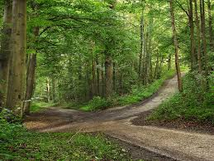
Monitoring and Evaluation of Peacebuilding Interventions

Slide 3
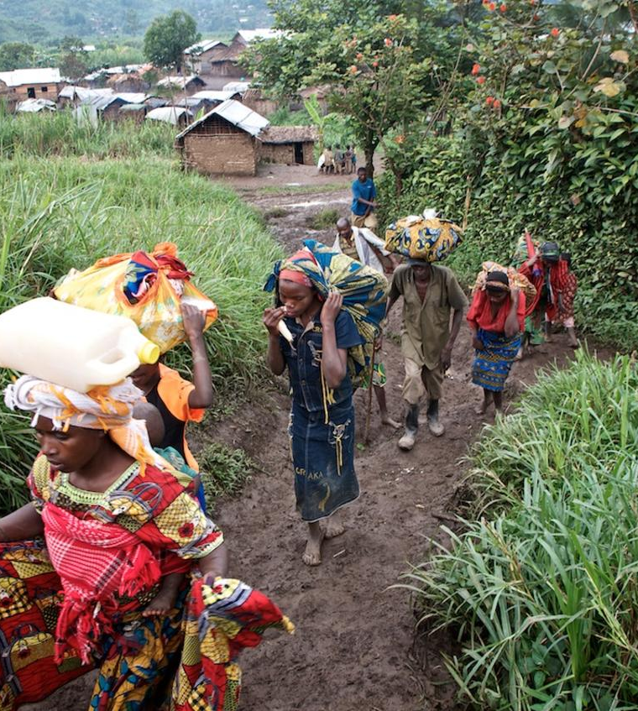
Looking Back:
What has been achieved
Peacebuilding M&E Guidance
Frameworks of Analysis of Conflict
Indicators and Methods
Strengthen capacity

Slide 4

But M&E of Peacebuilding is not easy
Common Challenges:
Dynamic and Complex Contexts
Adaptable and Flexible programming
Intangible Concepts
Rapidly Designed Projects
Working within and outside systems and institutions

Slide 5

Where we need to grow:
Monitoring for Peacebuiding outcomes
Evaluate with intention
Using Existing Data and Evaluations
Share Evidence and Evaluations widely

Slide 6
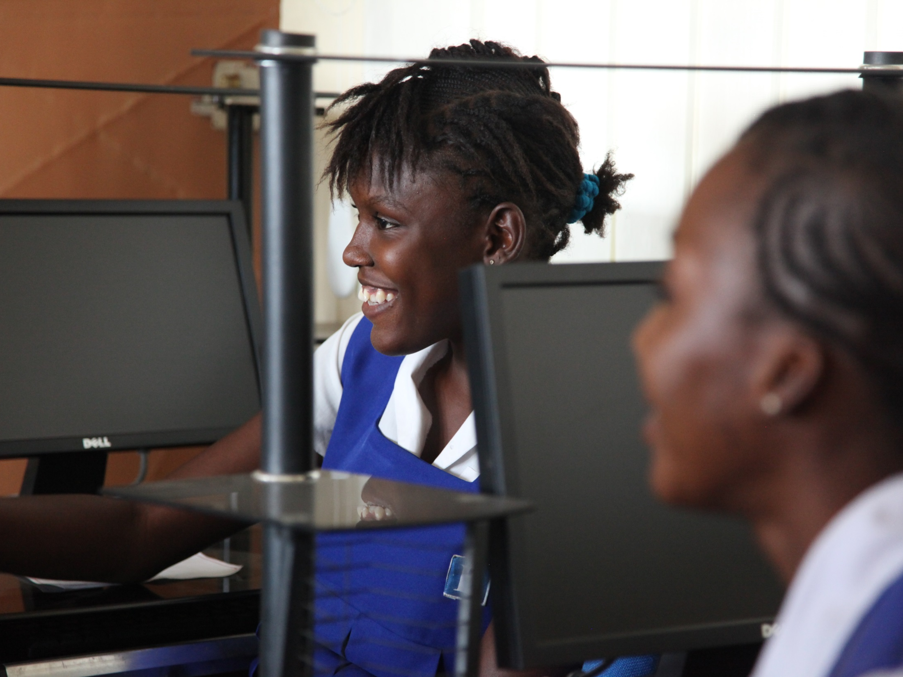
UnCommon Solutions

Slide 7
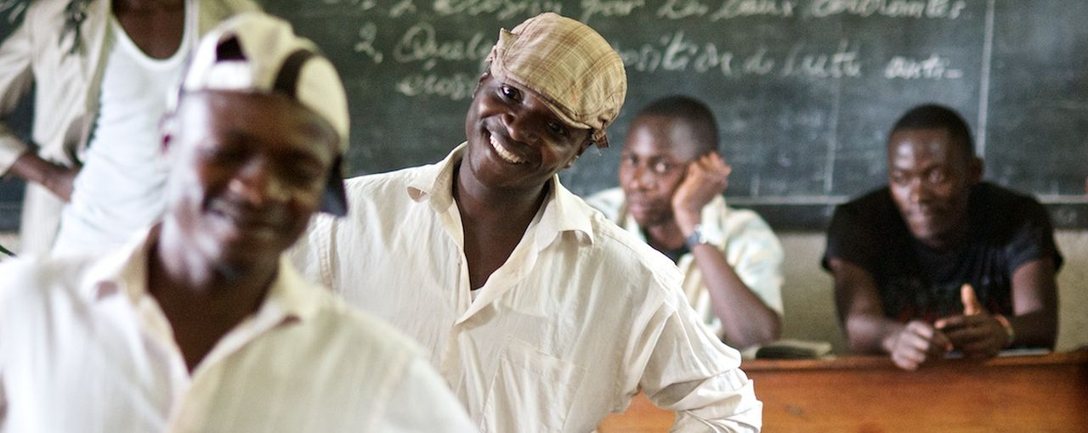
1. Rethinking our System, Creating Common Good Projects, and Managing Data Expectations

Slide 8
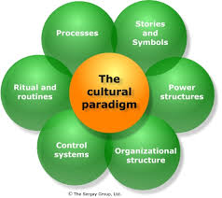
2. Focus Within: Shift Organizational
Culture
People
Leadership matters!
Structures
Rituals and Routines
Accountability
Processes

Slide 9
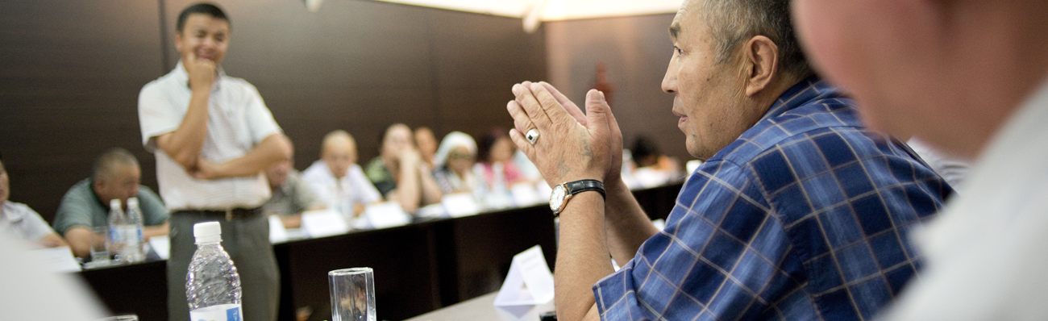
3. Evaluating our Methods and Approaches for Monitoring and Evaluation

Slide 10
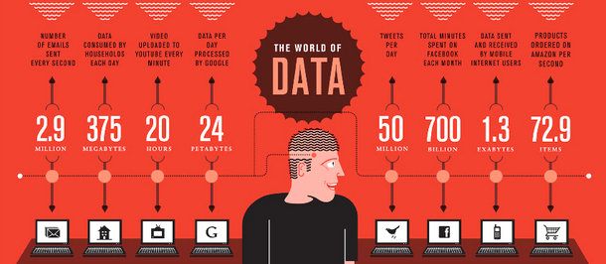
4. Opportunity of Technology

Slide 11
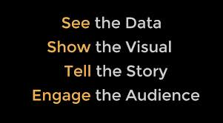
4. Opportunity of data visualization to improve use

Slide 12

2015 Year of Evaluation:
What does it mean for M&E of Peacebuilding Interventions?

Slide 13

Thank you
Vanessa Corlazzoli
Search for Common Ground
vcorlazzoli@sfcg.org
March 2015

