Slide 1
Communications and Knowledge Management
GEF Independent Evaluation Office
Evaluation Practice Exchange
Juan Jose Portillo
Senior Operations Officer
Kseniya Temnenko
Knowledge Management Officer

Slide 2
GEF Independent Evaluation Office
Mission:
Enhance global environmental benefits through excellence, independence, and partnership in monitoring and evaluation.
Functions:
Independent GEF Evaluation
Normative function
Oversight function
Knowledge sharing and dissemination
Brief history:
1996 — Initially established as an M&E unit within the GEF Secretariat
2003 — The M&E unit was made independent of the GEF Secretariat
2005 — The unit was renamed as GEF Evaluation Office
2013 — The office was renamed as GEF Independent Evaluation Office

Slide 3

Example 1

Slide 4
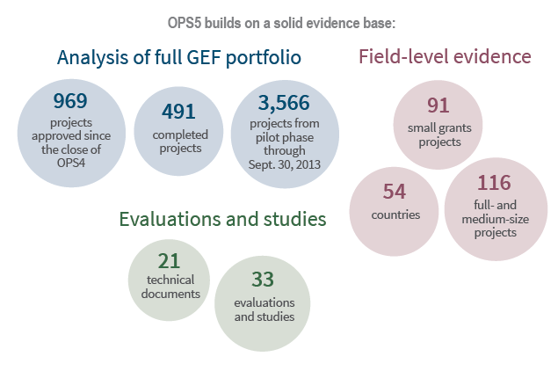
OPS5
FIFTH OVERALL PERFORMANCE STUDY OF THE GEF
Main Conclusions and Recommendations
OPS5 is a comprehensive evaluation that assesses the performance, institutional
effectiveness, and impact of the GEF. Overall performance studies are undertaken to
inform the next replenishment cycle of the GEF and to identify potential improvements

Slide 5
First Year of OPS5 vs. OPS4

Slide 6
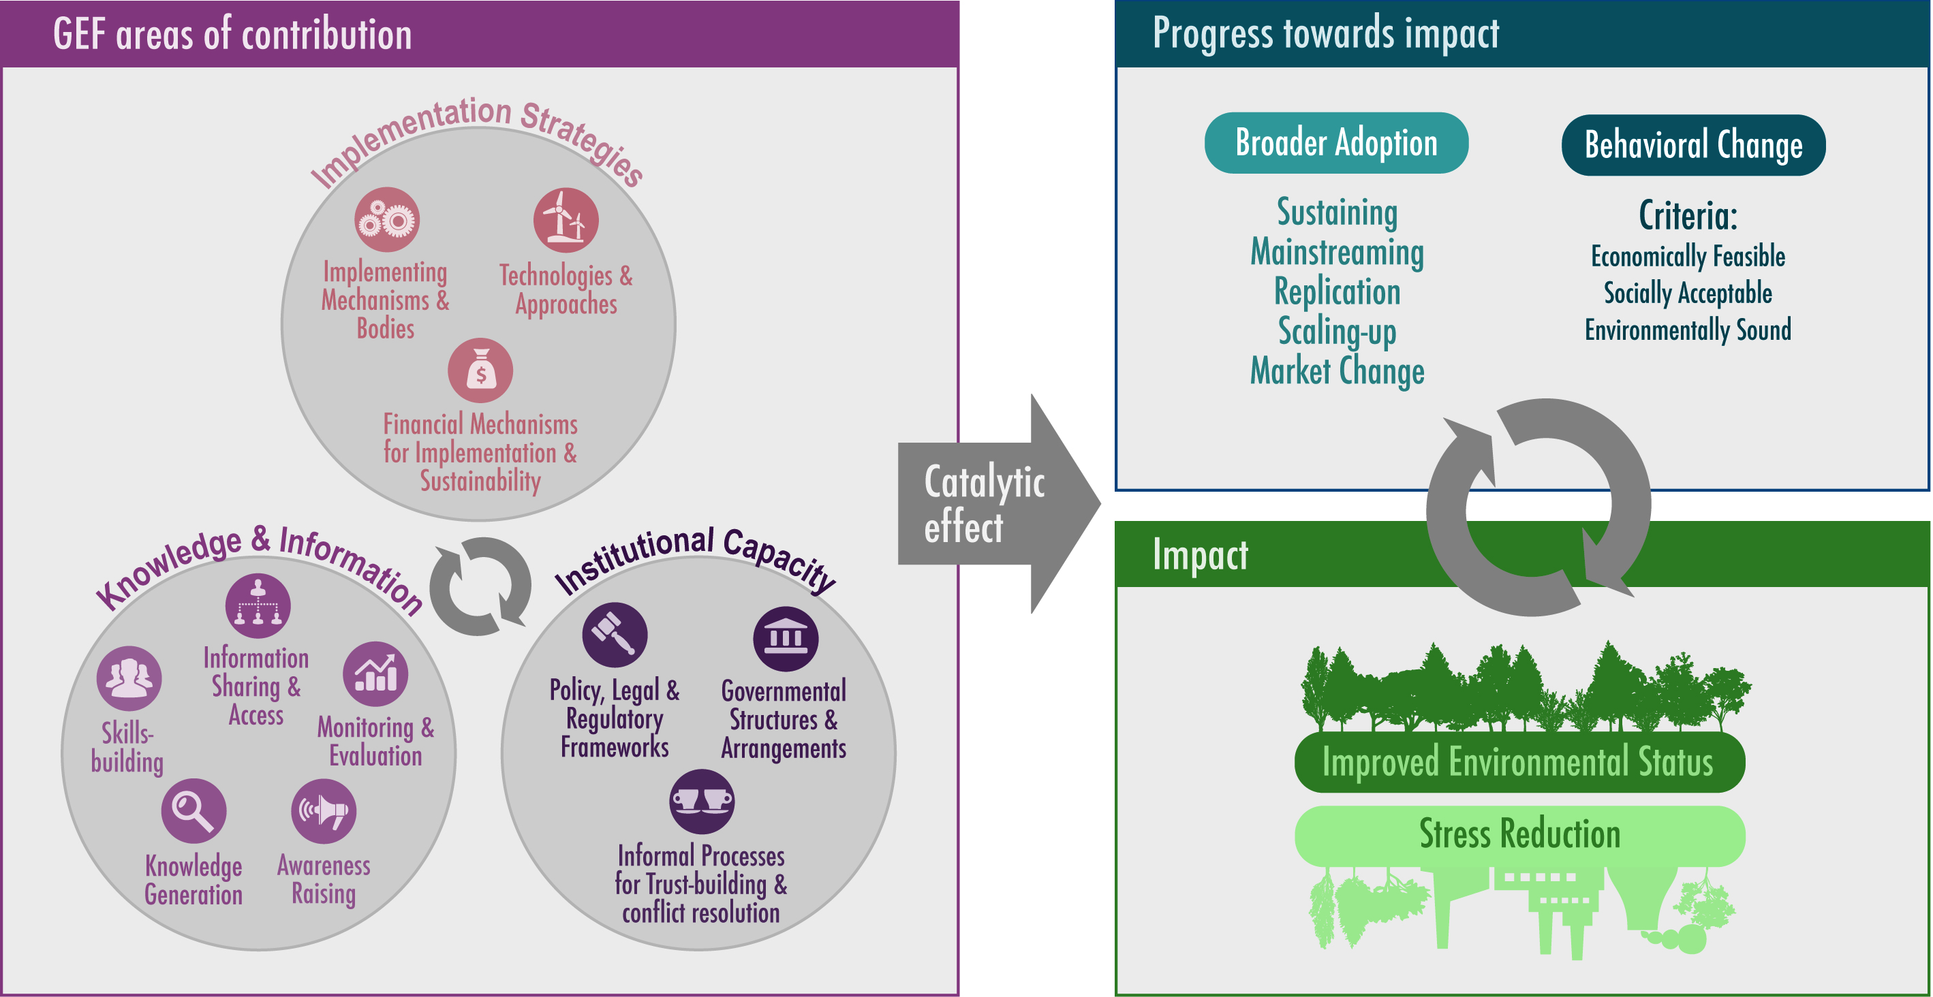
Example 2: Broader Adoption

Slide 7
Notes:
We first tried to help communicate some of these terms in infographics. We kept getting questions - broader adoption of what? We thought that it should be communicated via storytelling. Should be converted into a story.
We came up with a story on energy efficient light bulbs. Based on GEF examples, and easy to relate.
Lessons learned:
Teamwork! Dedicated evaluator who is interested in making sure their work is translated and understood by general audiences. Cartoonist who is also a subject-matter expert. Cris Lysy. (freshpectrum). Voice over artist.
Takes time: 4-5 rounds.
95% conceptual work, 5% technical.
Concepts are the key, but keep an eye on images – does everyone understand them?
Make sure the story does not turn into promotion piece of your organization.
Simple Ipad technology.
Story – translate your concepts into a story understood by almost everyone.
Concrete examples that people can relate to, and practical (CO2 graph – heat waves, flooding; lamp and how it was replicated, and sustained, and scaled up). Use simple language.
Use: It has been watched 164 times; shown in the GEF Assembly; at the evaluation conference; at an orientation session for a new evaluation team (one of the country portfolio evaluations).

Slide 9
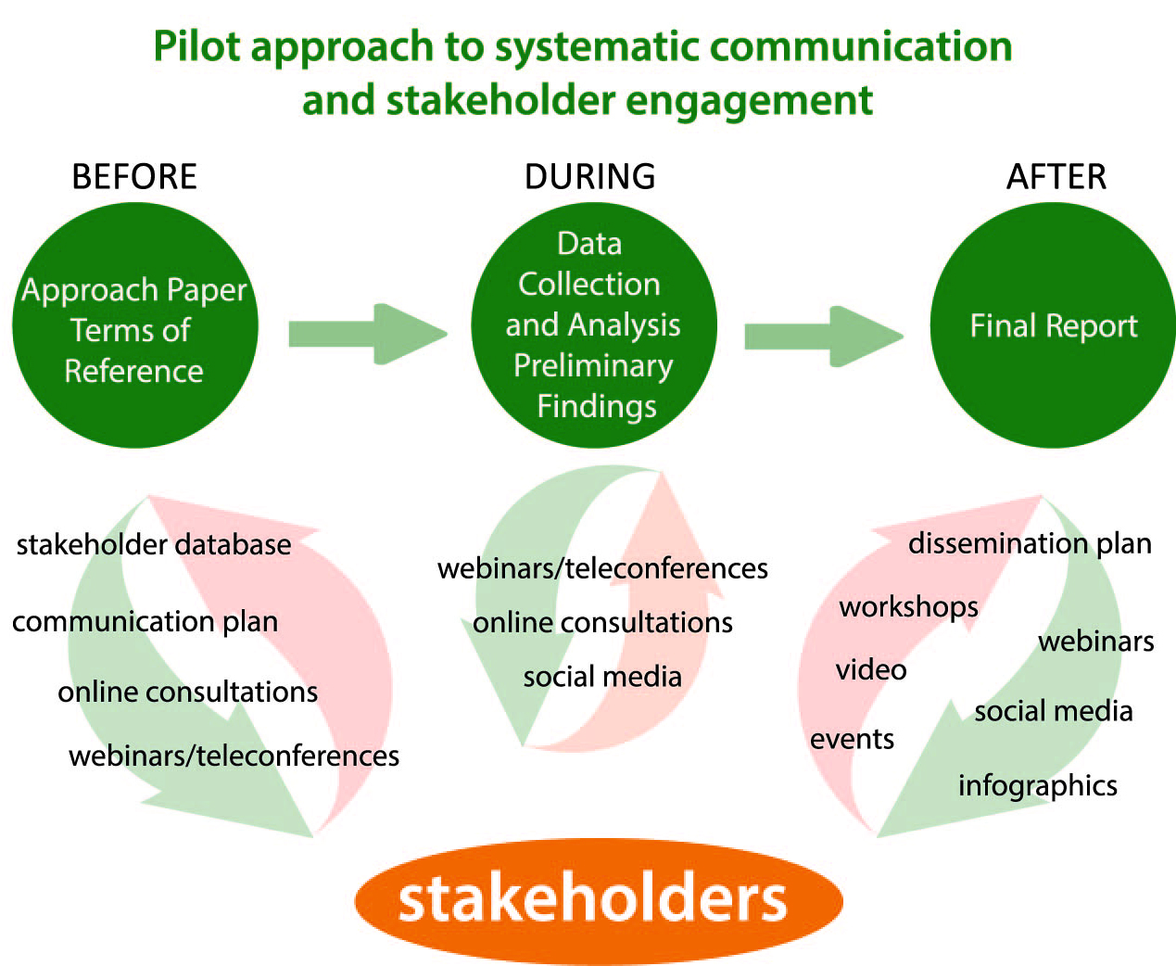
Example 3
Notes:
IEO is piloting a new approach to evaluation communications and stakeholder engagement with several evaluations. It is built on two frameworks, by Hallie Preskill (Guide for engaging stakeholders in development of evaluation questions) , and Glenn O’Neil (integrating communication in evaluation).
The approach involves systematic planning and implementation of consultations and stakeholder engagement. It adds on to excising consultation processes. The purpose is to make consultations more inclusive across the GEF Parthership. An open door for ongoing stakeholder consultation. Use discussion platforms and webinars.
Positive feedback – on the anecdotal level: Morocco—involved partners beyond those in the country, who are involved in the region (GEF Agencies) and other partners – STAP. National stakeholders appreciate opportunity to be informed and provide feedback in targeted moments of the evaluation process. Overall we will have a progress report by the end of this fiscal year.

