Slide 1

Evaluation Practice Exchange Seminar
13th March 2015
Scene setting: humanitarian crises and evaluation issues
Anne-Claire Luzot
Senior Evaluation Officer,
WFP Office of Evaluation

Slide 2
Structure of the presentation
Humanitarian crises and response
Humanitarian action
Evaluating humanitarian action (EHA)

Slide 3
Humanitarian crises

Slide 4
Range of humanitarian crises
Rural
&
urban
Sudden
&
slow-onset
Natural disasters
&
human induced crises
Short-term
&
protracted
Tsunami
vs
Syria crisis
Earthquake vs
drought
Floods
vs
Darfur
Earthquake in rural Pakistan
vs
Earthquake in Haiti
Overall increasing in numbers and in complexity

Slide 5
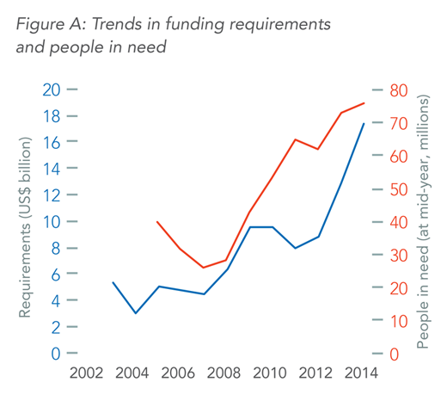
Funding requirements and people in need
In 2013, 148 million people affected by natural disasters or displaced by conflict
In 10 yrs
People in need multiplied by 2
Requirements multiplied by 4
http://www.unocha.org/data-and-trends-2014/img/graph-funding-people.png

Slide 6
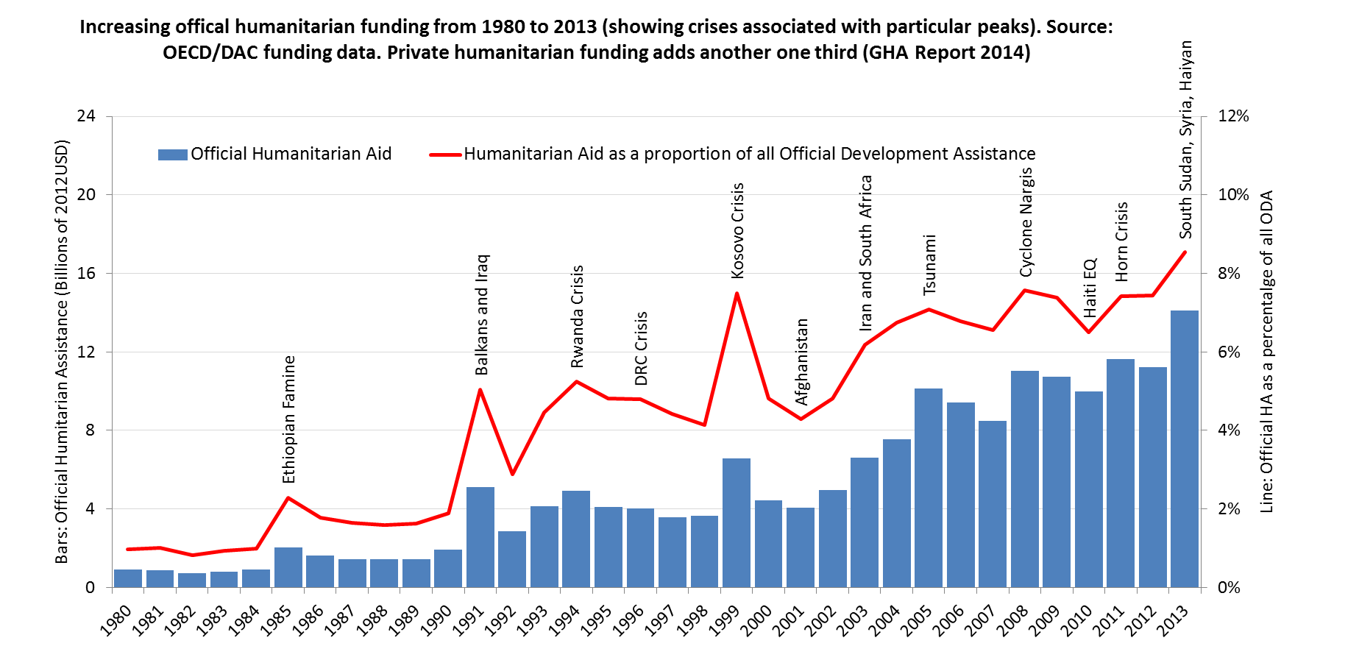
Humanitarian aid funding

Slide 7
ODA and HA (2010-12) in Million USD
13 of the 20 most important recipient of ODA are also the main recipient of HA over the period
Source: Global Humanitarian Assistance Report 2014

Slide 8
UN Agencies active in the humanitarian sector in 2015 (and maybe more)
UNESCO
UNDSS
UNICEF
UNAIDS
UN WOMEN
FAO
UN OCHA
UN HCR
UNWRA
UNODC
UNFPA
UNMAS
UN HABITAT
UNDP
WFP
ILO
UNIDO
WHO
More than 20 UN Agencies are regularly active in the humanitarian sector
UNOPS
Source: UN OCHA FTS

Slide 9
Humanitarian aid funding key trend
Year | Funding requirements (in billions $) | Number of Agencies involved
2005 | +/- 6 | +/- 165
2010 | +/- 11 | +/- 625
2013 | +/- 13 | +/- 700
Increasing fragmentation of humanitarian action

Slide 10
Complex and evolving international humanitarian system
Complexity
Increasingly complex crises
Multitude of actors with varied experiences, profiles and perspectives
  Evolving system
Humanitarian reform (2005) (Clusters, CERF)
Transformative Agenda (2011) (system wide protocols)

Slide 11
Humanitarian action

Slide 12
  What do we mean by humanitarian action?
  “Action taken with the objective of saving lives and livelihoods, alleviating human suffering and maintaining human dignity during and after human-induced crises and natural disasters, as well as to prevent and prepare for them”
  (ALNAP, Evaluating Humanitarian Action pilot guide)

Slide 13
Humanitarian
Principles
Humanity
Human suffering must be addressed wherever found. The purpose of Humanitarian Action is to protect life and health and ensure respect for human beings
Neutrality
Humanitarian actors must not take sides in hostilities or engage in controversies of a political, racial, religious or ideological nature
Impartiality
Humanitarian action must be carried out on the basis of need alone, giving priority to the most urgent cases of distress and making no distinctions on the basis of nationality, race, gender, religious belief class or political opinion
Independence
Humanitarian action must be autonomous from the political, economic, military or other objectives that any actor may hold with regard to areas where humanitarian action is being implemented

Slide 14
Humanitarian Principles
Adopted in 1965 by the Red Cross and Red Crescent Movement
Neutrality, Impartiality and Humanity adopted by General Assembly in 1991
Independence adopted by General Assembly in 2004

Slide 15
Humanitarian Standards
Provide a normative reference point, against which to evaluate
Can help to break down humanitarian action into smaller components that are easier to assess
Most widely used in evaluation are the Sphere Standards
- Core standards (People and Process)
- Technical standards covering various sectors

Slide 16
Humanitarian action

Slide 17
Evaluation of Humanitarian Action (EHA)
Investment in EHA from mid-to late 1990s
associated with increasing demand for accountability in the humanitarian aid sector
triggered by growing concern over the poor and varied performance of humanitarian agencies.

Slide 18
Humanitarian evaluation criteria
Appropriateness
of humanitarian activities to local needs
Coverage
Assistance reaching all affected population groups
Connectedness
take longer term and interconnected problems into account
Coherence
Extent to which there is consistency between development and humanitarian aid
Coordination
With all actors promoting synergies and avoiding duplication and gaps

Slide 19
Evaluation of Humanitarian Action (EHA) – current status
Coordination of EHA still a challenge eg Haiti, Somalia.
  Only 2 system-wide evaluations: Rwanda and tsunami
  But increasing interest for joint evaluations. For instance the Inter-Agency Evaluations of Humanitarian Action (IAEHA – system wide level 3 emergencies)

Slide 20
Evaluation of Humanitarian Action (EHA) – current status
Current concerns in EHA:
  How to move away from a development framework to evaluation?
  How to improve the record of evaluation utilization?
  Developing more learning-oriented approaches eg real-time evaluations or operational reviews
  Commitment to strengthening accountability to affected populations ?

Slide 21
Common challenges (1)
Most evaluation limitations are magnified
Lack of planning documents, unclear objectives, missing theories of change, early plans quickly outdated, moving targets
What do you evaluate against?
Lack of data, including baseline data
Within the short timeframe of an evaluation, and in the absence of usable monitoring data, how do you collect all the data you need without a baseline as reference?

Slide 22
Common challenges (2)
High turnover of stakeholders (staff, counterparts, partners, etc.)
Population movements Difficult to find key informants
Insecurity means lack of access in conflict environments
How can evaluators reach the affected population?

Slide 23
Gaps / issues
How to assess the humanitarian principles?
Innovation in evaluation methods to adapt to humanitarian context
Accountability to affected population
Ethics of evaluation in a climate of trauma, abuse and violence, and breakdown of trust

Slide 24
Thank you

