Slide 1
Humanitarian Evaluation
Practical challenges
UNEG: New York, 13 March 2015

Slide 2
IRAQ: IFRC (2003 and later)
HAITI: IFRC (2010) Post-Earthquake RTE
Norwegian Red Cross: Emergency Hospital eval. (2010)
Concern Worldwide: Relocating the camps (2012)
MYANMAR: IFRC (2011)
SOMALIA: Norwegian Refugee Council (2011)
WFP (2012) Evaluation of the Country Portfolio
SUDAN: WFP (2013) Evaluation of the Country Portfolio

Slide 3
What contexts?
Sudden onset such as after a natural disaster, especially where law and order has broken down (Haiti)
Ongoing conflict: Syria / Iraq
Post-conflict, especially without official controls and/or there is no government (Iraq)
Longer-term complex situations: internal political issues, excessive control, lack of official support, direct obstruction, maybe compounded by natural disasters etc (Darfur, Myanmar, parts of Somalia)
Total breakdown of the state + + : (Somalia)

Slide 4
The contexts
Countries with humanitarian assistance programmes are, by definition, dysfunctional and unable to deliver such support themselves
Absence of strong official / government structures and systems
Often this breakdown means lack of access to baseline data etc, or to knowledgeable staff
Increased external intervention, particularly with expatriates, creates increased tension

Slide 5
Security considerations
Agencies have a duty of care to their staff, but still have to find ways to operate and evaluate
Security regulations are tightened – especially rules for programme staff to follow, frequently leading to a ‘bunker mentality’
UNDSS regulations over access, visits, travel, curfews etc.
Use of armed escorts – right or wrong?
Can / should evaluators go where staff cannot?
Restrictions on photography etc
Does advance planning help … or add to … the risks?

Slide 6
The imbalance of power
Political pressures and expectations
Between clans / groups
Between leaders and the communities
Within the communities themselves, esp. around gender and age issues

Slide 7
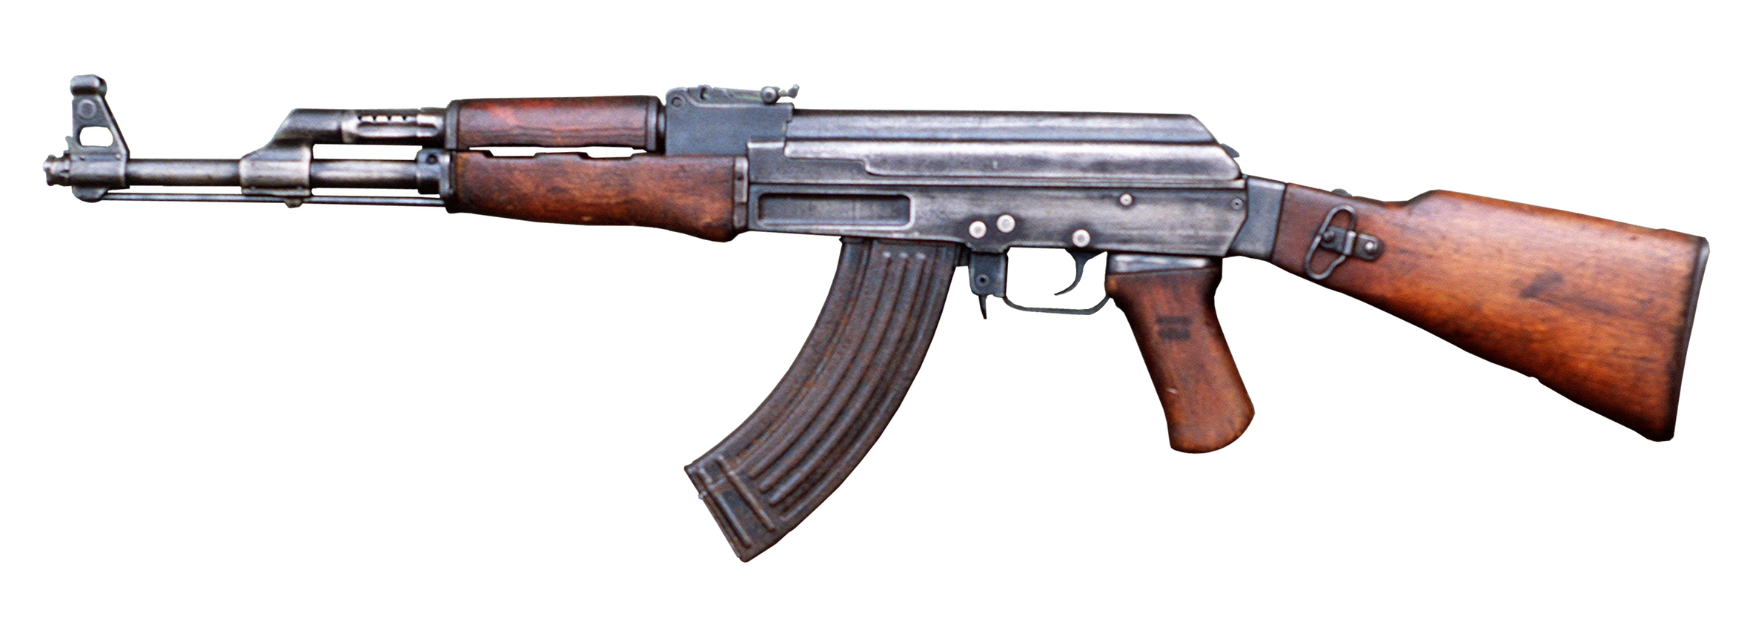
The power differentials
Evaluation ‘at gunpoint’?
Do we even notice the weapons?
Do they affect what we ask or hear or discuss?
How can we mitigate this effect?

Slide 8
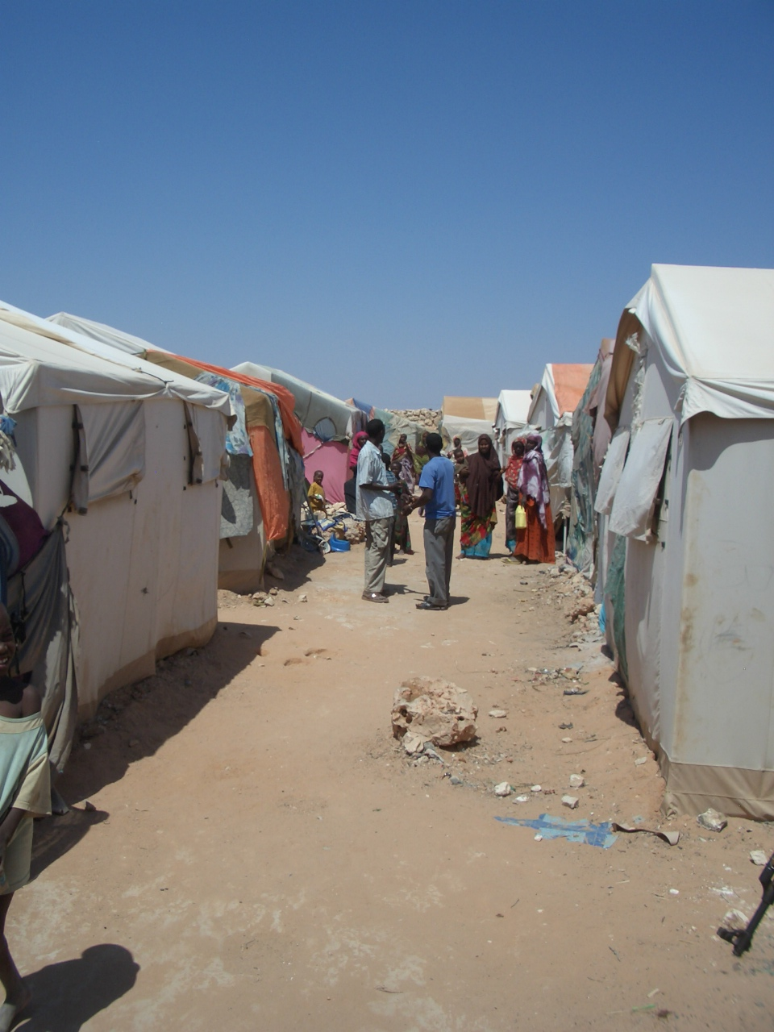
IDP Camp, Galkaiyo, Puntland (Somalia)
November 2011

Slide 9
IDP Camp, Galkaiyo, Puntland (Somalia)
November 2011

Slide 10
The expected constraints
Access limitations, especially away from main routes
Insufficient time requires good project selection in advance (for planning purposes & clearances)
‘Controlled’ access to beneficiaries
Availability of data, esp. baselines

Slide 11
The expected constraints
Logistical issues and delays
Changing contexts, particularly during active unrest situations
Disrupted or incomplete institutional memory
Multiple and remote locations

Slide 12
Evaluation in these contexts
Ensure the team has a deep understanding and appreciation of the context
Remain flexible (and positive!)
Some programming can be done remotely – but how effective for monitoring & evaluation?
Triangulation of data and feedback as much as possible
Acknowledge constraints in the report

Slide 13
Adapting the methods
If we cannot go to the stakeholders, can they come to us?
  How can this be organized?
  Is it safe to ask them to do so?
  Do we get access to a representative sample, or the ‘big players’?
  How can we realistically feed back any findings?
How do we minimise the risk to all sides but ensure access, inclusion and a balance of stakeholders?

Slide 14
Adapting the methods
Use of agency telephone lists in some cases
Make ‘spot check visits’, ie those not programmed in advance
Consider and plan for internet and communications challenges

Slide 15
Flexibility is vital
Plan for the unexpected: expect plans and schedules to change
Leave time between meetings /interviews, but aim for broad coverage
‘Down time’ does not have to be wasted
Seize opportunities as they develop: (eg: walk about the markets; welcome spontaneous requests for meetings)

Slide 16
Evaluation in these contexts
Engage and spend time with the assisted people and talk to non-beneficiaries and agencies
Double check the ‘innovations’ – hotlines, GPS records, pictures, signage
External evaluators have the ability to compare across agencies and settings

Slide 17
Evaluation in these contexts
‘Comfort zones’ should be challenged – be innovative and welcome change
Institutional knowledge often greater with national staff
Consider the reputation of the agency – get out of the bunker; engage …
Institutional vs. personal? … though new teams bring new approaches.

Slide 18
Frameworks & guidance
The Sphere Standards (from 1997)
‘Do No Harm’ initiative (1999)
UNEG Norms and Standards (2005)
OECD-DAC Principles for Good International Engagement in Fragile States (2007)
UNEG Ethical Guidelines (2008)

Slide 19
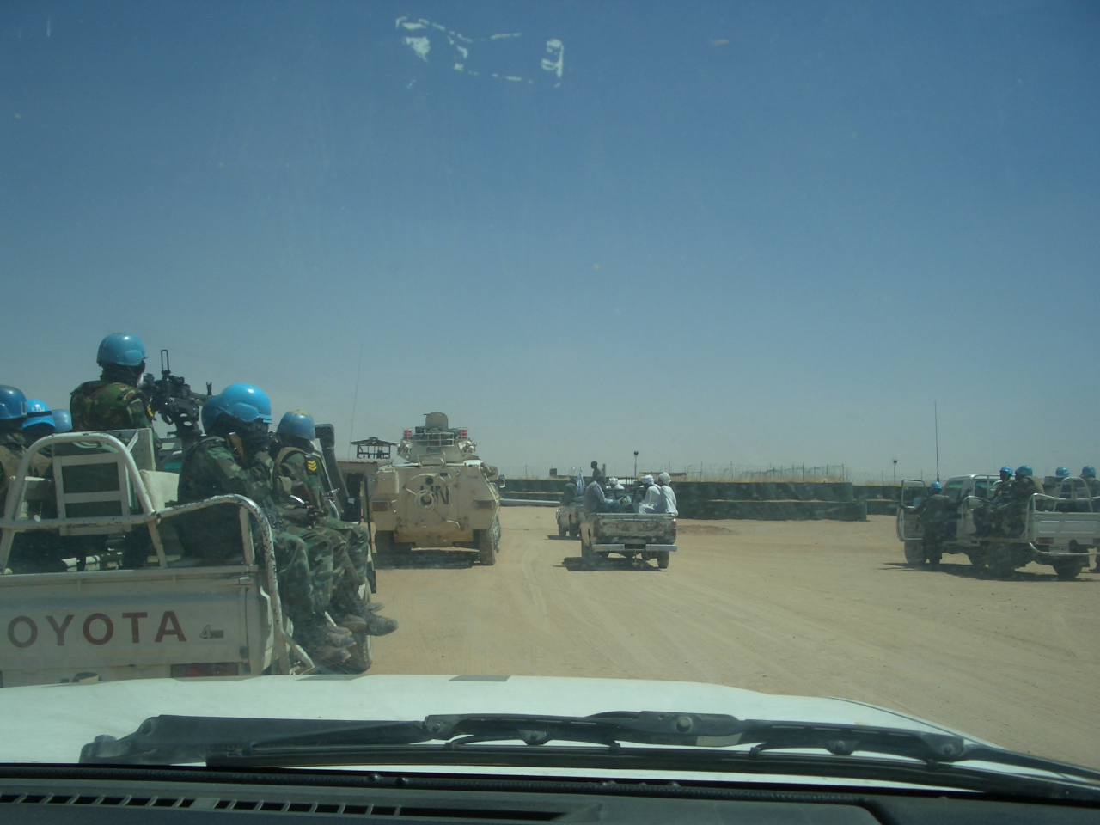
“Get out of the bunker”

Slide 20
One evaluation team and national NGO partners

Slide 21
+
One armoured car

Slide 22
+
Four pickups and about 30 heavily armed UN troops

Slide 23
To the beneficiaries, what does this say about:
Good use of limited time and resources?
Value added?
Presence of weapons?
Impartiality?
Agency reputation?
North Darfur, April 2013

