Slide 1
Humanitarian Evaluation:
Practical challenges
UNEG: New York, 13 March 2015

Slide 2
IFRC: Iraq (2003 and later)
IFRC: Haiti (2010) – Post-Earthquake Real-Time Evaluation
Norwegian Red Cross: Haiti (2010)
Concern Worldwide: Haiti (2012)
IFRC: Myanmar (2011)
Norwegian Refugee Council: Somalia (2011)
WFP: Somalia 2012
Evaluation of the Country Portfolio 2006-2010
WFP: Sudan 2013
Evaluation of the Country Portfolio 2010-2012
Notes:
As the overall theme of this Panel is whether the evaluation of humanitarian programmes is adapting and appropriate in increasingly difficult contexts, this brief presentation will offer some specific examples of the issues and challenges faced by the field teams in several recent evaluations in difficult environments – Haiti post-earthquake with the violence and scale, especially in the slum areas; Sudan and Somalia with WFP, in both cases multi-programme, multi-year reviews of a wide range of the activities in often very difficult environments.
The focus is on the practicalities of doing the evaluation and not the programming itself, and presents a series of questions that need to be considered when this work is being planned and undertaken.

Slide 3
What contexts?
Sudden onset such as after a natural disaster, especially where law and order has broken down (Haiti)
Ongoing conflict: Syria / Iraq
Post-conflict, especially where law and order has broken down and/or there is no government (Iraq)
Longer-term complex situations: internal political issues, excessive control, lack of official support, direct obstruction, maybe compounded by natural disasters etc (Darfur, Myanmar, parts of Somalia)
Total breakdown of the state + + : (Somalia)

Slide 4
The contexts
Countries with humanitarian assistance programmes are, by definition, dysfunctional and unable to deliver such support themselves
Absence of strong official / government structures and systems
Often this breakdown means lack of access to baseline data etc or to knowledgeable staff
Increased external intervention, particularly with expatriates, creates increased tension
Notes:
Humanitarian interventions are only required in countries which are not able to fulfil their own official obligations towards their own people; or those which may choose not to do so for one reason or another.
a) Putting humanitarian actors into such contexts inevitably changes the status quo; issues such as national pride; neo-colonialisation; agency staff often seen as ‘spies’ or ‘informers’, particularly in areas of tension/conflict (eg: Sudan)
b) Many countries, because of or as a result of, its recent past, have weak or inadequate structures and systems and access to official data. Some official structures, esp in Puntland/Darfur, slowly being built up with UN assistance. WFP (and others) had been very supportive in development of ‘national’ policies and other assistance.
c) However this also means there is often limited institutional memory within the authorities and they are challenged with issues like staff capacity, resources, transport etc

Slide 5
The imbalance of power
Political pressures and expectations
Between clans / groups
Between leaders and the communities
Within the communities themselves, esp. around gender and age issues
Notes:
But not only guns … The balance of power between and within groups and factions is well known to the people but has to be learnt by the agencies, and these things change all the time.
Even within communities, cultural issues may prevent the free flow of information … for example, do [male] leaders convey the needs of the women and girls; do the leaders have other political connections / interests / sources of income which impacts impartiality?; do they allow free discussion with all parts of their community (eg: Darfur example of sheiks at gate)
Leaders (as main interlocutors) to agencies: “we tell you what we think you want to hear”; we don’t want to jeopardize what we have now … we have a duty to look after our people = we have a position of power to maintain.
Beneficiaries (to evaluators) will often suggest other priorities or issues not mentioned by their leaders. Eg: vulnerable group assistance, el geneina
In some contexts the UN works with armed escorts (duty of care). But might this actually compromise the activities (both programmes and evaluations)? Do we know exactly who these escorts are or who they represent or report to?.

Slide 6
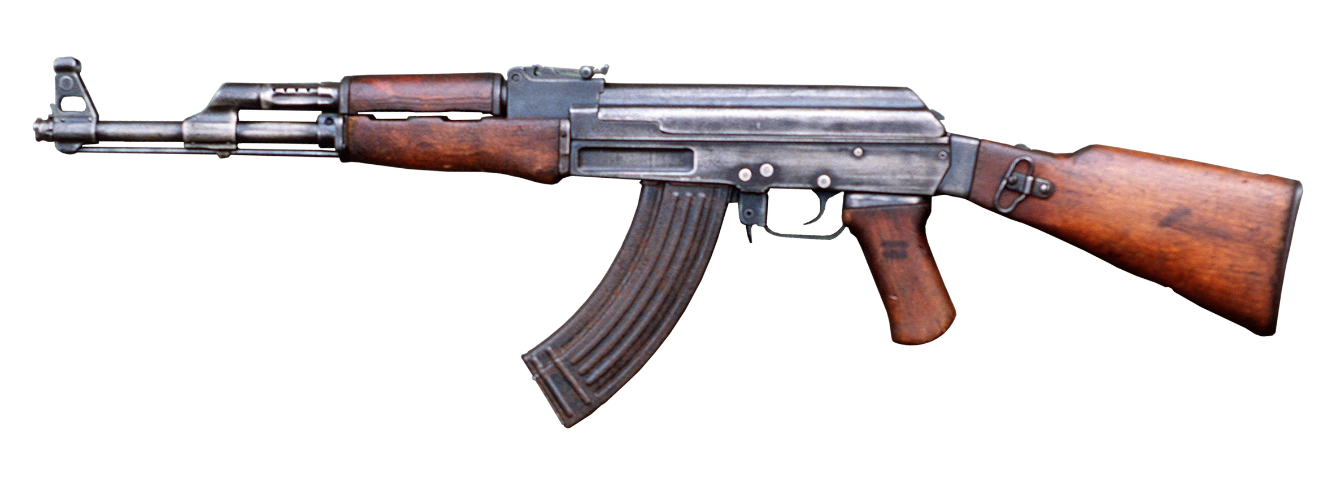
The power differentials
Evaluation ‘at gunpoint’?
Do we even notice the weapons?
Do they affect what we ask or hear or discuss?
How can we mitigate this effect?
Notes:
In such countries guns are everywhere, displayed and hidden.
Evaluation “at gunpoint”?
Do we even notice them?
Do they affect what we ask or hear or discuss?
How can we mitigate this effect?

Slide 7
Security considerations
Agencies have a duty of care to their staff, but still have to find ways to operate and evaluate
Security regulations are tightened – especially rules for programme staff to follow, frequently leading to a ‘bunker mentality’
UNDSS regulations over access, visits, travel, curfews etc.
Use of armed escorts – right or wrong?
Can / should evaluators go where staff cannot?
Restrictions on photography etc
Does advance planning help … or add to … the risks?
Notes:
Security is a major consideration and limiting factor, in Somalia for example in South/Central and Mogadishu. UN or other agency rules for staff welfare often restrict their movement (a later slide gives an idea of how this was handled in Somalia).
Mark Duffield (Uni of Bristol) writes how aid managers, addressing their perceived risks, are increasingly developing ways of remote programme management and “withdrawing to secure-gated complexes” which inevitably creates barriers of understanding and support with the aid recipients. This leads to a lack of understanding of the coping strategies and resilience the communities themselves exhibit. This creates a balance of need between appropriate programming for the context set against questions of longer-term dependency and sustainability
Thus staff / evaluators often fly in / fly out for short visits or arrive in fleets of white Land Cruisers etc etc.. Eg: warehouse visit in Somalia

Slide 8
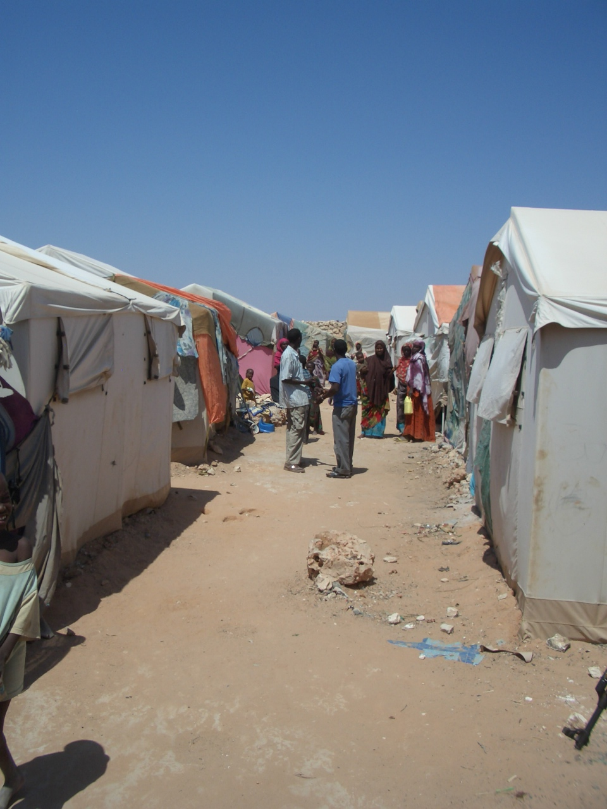
IDP Camp, Galkaiyo, Puntland (Somalia)
November 2011
Notes:
As an example, here is a picture from an evaluation in central Somalia - taken in a temporary IDP settlement near Galkayo during a previous mission.

Slide 9
IDP Camp, Galkaiyo, Puntland (Somalia)
November 2011
Notes:
Here is the whole picture: I could not find a single photo from that trip without a gun or a guard in evidence and the four armed guards stuck closely to the evaluation team. Although these guards were there to protect us, could they have been reporting back to one warlord or another (or none) [they were ‘official’ policemen].
Would there have been any repercussions on the people for telling us something ‘negative’, or indeed would the people have told us with the guard present? We had to find ways to get away and interview people without them being there.

Slide 10
The expected constraints
Access limitations, especially away from main routes
Insufficient time requires good project selection in advance (for planning purposes & clearances)
‘Controlled’ access to beneficiaries
Availability of data, esp. baselines
Notes:
Designing an evaluation and going into such countries implies we will face a number of constraints … beyond the security, there are many similarities between these ‘difficult’ contexts :
a) Away from main urban centres or roads, access is increasingly problematic – in terms of distance or safety, and usually in terms of time. While this highlights the operating conditions for the agency, not all sites can be visited and some decisions must be made on what is possible / realistic versus ensuring a broad overview of the programme’s activities.
b) Time (because of budgets etc) usually insufficient for what would be ‘ideal’. Thus snapshots have to be taken. Eg: Sudan .. Major logistics operation but not enough time to be able to visit major logs hub. Thus it is important to select and agree a good spread of activity but not assume all can be covered/visited.
c) Often planning data is either not available or no longer relevant. Eg: for WFP sometimes emergency interventions with displaced populations (requiring GFD) develop into longer term support activities (requiring more targeted approaches). Monitoring becomes outputs rather than outcomes as there are no benchmarks.
Also: warehouse example from Gedaref = data all secondary, on trust, unverifiable.

Slide 11
The expected constraints
Logistical issues and delays
Changing contexts, particularly during active unrest situations
Disrupted or incomplete institutional memory
Multiple and remote locations
Notes:
Continuing the same theme:
a) Limited logistics capacity adding strains to the programme; eg: use of UNHAS flight where available; road transport (in Puntland) requiring double vehicle police escort
b) Contexts change fast – front lines move, security incidents occur (eg: kidnapping in Nyala, shooting in market delaying return helicopter). Eg: US Navy Seal attack on Galkaiyo the night before our arrival
c) Institutional memory frequently an issue due to high turnover, particularly of expatriate staff. Some people ‘traumatised’ and not willing to speak to the team (or maybe that’s just because we are just more evaluators!). National staff often have longer term knowledge, better contact with the communities; but frequently on short-term contracts and feeling undervalued. Need to encourage their participation (= time required) and be prepared to advocate on their behalf.
e) Somalia Country office in Nairobi created a certain sense of ‘us and them’: field being a field office in Somalia, ‘deep field’ being outside the gates. Sudan (until 2011) operating as a series of separate offices. These structures impact upon responsiveness and appropriateness, and discourage unified approaches

Slide 12
Evaluation in these contexts
Ensure the team has a deep understanding and appreciation of the context
Remain flexible (and positive!)
Some programming can be done remotely – but how effectively for monitoring & evaluation?
Triangulation of data and feedback as much as possible
Acknowledge constraints in the report
Notes:
Evaluation in such contexts goes well beyond the review of the programming itself – and much depends on a good knowledge of the background, history, politics, current realities of the operating context. Selecting team members with this knowledge as well as direct technical skills is critical. Eg: in Somalia, 7 of 8 team members had prior Somali experience.
Flexibility is key – expect plans and schedules to change. People living and working in the context also understand this. Eg: Gedaref: despite permits etc, one policeman’s intransigent attitude meant 400km detour and 24 hrs wasted, meetings cancelled or postponed etc.
Some programming can be done remotely, but can evaluation be done remotely? Eg: Yemen?
Keep people informed – not only for security reasons. This will often elicit spontaneous approaches by people not in the schedule.
Humanitarian assistance is emotive: everyone has different views and experiences, and the range of information must be checked and cross-checked wherever possible.

Slide 13
Adapting the methods
If we cannot go to the stakeholders, can they come to us?
  How can this be organized?
  Is it safe to ask them to do so?
  Do we get access to a representative sample, or the ‘big players’?
  How can we realistically feed back any findings?
How do we minimise the risk to all sides but ensure access, inclusion and a balance of stakeholders?
Notes:
Evaluation in such contexts goes well beyond the review of the programming itself – and much depends on a good knowledge of the background, history, politics, current realities of the operating context. Selecting team members with this knowledge as well as direct technical skills is critical. Eg: in Somalia, 7 of 8 team members had prior Somali experience.
Flexibility is key – expect plans and schedules to change. People living and working in the context also understand this. Eg: Gedaref: despite permits etc, one policeman’s intransigent attitude meant 400km detour and 24 hrs wasted, meetings cancelled or postponed etc.
c) Eg: visit distributions not programmed for a visit; walk about markets; talk to traders and non-beneficiaries
Keep people informed – not only for security reasons. This will often elicit spontaneous approaches by people not in the schedule.
Humanitarian assistance is emotive: everyone has different views and experiences, and the range of information must be checked and cross-checked wherever possible.

Slide 14
Adapting the methods
Use of agency telephone lists in some cases
Make ‘spot check visits’, ie those not programmed in advance
Consider and plan for internet and communications challenges
Notes:
Evaluation in such contexts goes well beyond the review of the programming itself – and much depends on a good knowledge of the background, history, politics, current realities of the operating context. Selecting team members with this knowledge as well as direct technical skills is critical. Eg: in Somalia, 7 of 8 team members had prior Somali experience.
Flexibility is key – expect plans and schedules to change. People living and working in the context also understand this. Eg: Gedaref: despite permits etc, one policeman’s intransigent attitude meant 400km detour and 24 hrs wasted, meetings cancelled or postponed etc.
c) Eg: visit distributions not programmed for a visit; walk about markets; talk to traders and non-beneficiaries
Keep people informed – not only for security reasons. This will often elicit spontaneous approaches by people not in the schedule.
Humanitarian assistance is emotive: everyone has different views and experiences, and the range of information must be checked and cross-checked wherever possible.

Slide 15
Flexibility is vital
Plan for the unexpected: expect plans and schedules to change
Leave time between meetings /interviews, but aim for broad coverage
‘Down time’ does not have to be wasted
Seize opportunities as they develop: (eg: walk about the markets; welcome spontaneous requests for meetings)
Notes:
Flexibility is key –. People living and working in the context also understand this. Eg: Gedaref: despite permits etc, one policeman’s intransigent attitude meant 400km detour and 24 hrs wasted, meetings cancelled or postponed etc.
c) Eg: visit distributions not programmed for a visit; walk about markets; talk to traders and non-beneficiaries
Keep people informed – not only for security reasons. This will often elicit spontaneous approaches by people not in the schedule.

Slide 16
Evaluation in these contexts
Engage and spend time with the assisted people and talk to non-beneficiaries
Double check the ‘innovations’ – hotlines, GPS records, pictures, signage
External evaluators have the ability to compare across agencies and settings
Notes:
Re the bunker, in Somalia, for example, this was very apparent … WFP’s public face in Puntland – the food monitors – were primarily being used for compliance monitoring duties (counting bags) rather than a more significant interface with the assisted communities, such as through IEK activities or programme design amendments
b) Too often programmes are designed or amended by the agency without detailed consultation with the parties affected. Evaluations must make a point of spending time with the communities and talking semi-formally - and informally. This may sound obvious but it is surprising how often evaluators hear of this lack of direct contact – agencies not asking for direct input to decisions; not spending time to explore what is working or not (eg: appropriate targeting, reduction in rations). FGDs with communities are not all about lists of new demands and expectations – the people usually understand the agencies’ constraints but have ideas for change too: eg cash vs food, more appropriate food baskets, support to vulnerable families within their own communities. Evaluations need to give significant time to these forums.
c) The bunker situations produce ‘innovations’ which may or may not work. Eg: Hotlines a great idea, but how realistic? (Somali example). Cash/chip trialing in Sudan already well established in Kenya … but being ‘reinvented’ in Sudan.
d) Evaluators can often share valuable lessons from other settings which have been tried elsewhere. Agencies are not good are sharing results within or between themselves, and the wheel is continually reinvented.
e) Make sure the constraints are mentioned to avoid criticism later. Obvious really!

Slide 17
Evaluation in these contexts
‘Comfort zones’ are challenged – be innovative and welcome change rather than fight it
Because of expat turnover, institutional knowledge often greater with national staff
Consider the reputation of the agency – get out of the bunker; engage
Institutional vs. personal? … though new teams bring new approaches.
Notes:
Innovation and constant assessment/improvement challenges comfort zones: ‘we’ve done it for a long time, we know it works’. Evaluators can be a catalyst for this change, though maybe via direct challenges which are hard to hear
Important to talk with existing partners but also those who did not want to partner with main agency – what reasons, what experiences? Eg: does linking with a UN partner influence the perception of neutrality or impartiality?
Despite new approaches, a strong institutional loyalty (esp to outsiders/evaluators) so sometimes difficult to get the whole story. ET has to ensure issues are not personalized: people feel vulnerable, unable to make a significant difference, bound by corporate rules.
Humanitarian assistance is emotive: everyone has different views and experiences, and the range of information must be checked and cross-checked wherever possible.

Slide 18
Frameworks & guidance
The Sphere Standards (from 1997)
‘Do No Harm’ initiative (1999)
UNEG Norms and Standards (2005)
OECD-DAC Principles for Good International Engagement in Fragile States (2007)
UNEG Ethical Guidelines (2008)
Notes:
There are numerous frameworksto be considered by evaluators for seeing how the programming fits within the context, and allowing space for the links between political, security and developmental objectives:
Do No Harm: local capacities for peace: ensuring the programming is appropriate and not harmful (eg: Darfur)
The OECD-DAC Principles aim to look beyond the programme activities themselves and address how they fit in the bigger picture / context, and focus on the longer term view of reducing the fragility of the country itself and how the agency inputs can assist in that transition.
Examples from Somalia and Sudan – WFP assisting with the formulation of national policies on nutrition, school feeding etc.
Assistance with rehabilitation of ports and roadways – clearly for the immediate benefit of WFP’s own access, but significant infrastructural support also to the country or authority for the longer term
Working to strengthen local administrative systems at departmental level
Improved leadership and coordination

Slide 19
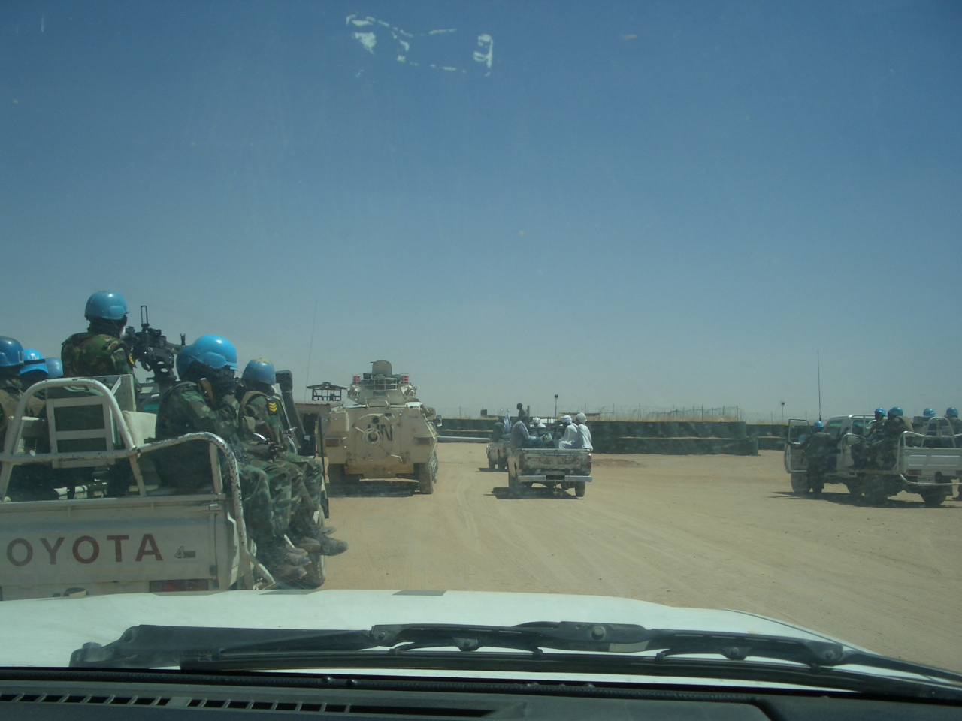
“Get out of the bunker”
Notes:
To close… I mentioned earlier ‘getting out of the bunker’ … Sure – we got out of the bunker …
One evaluation team and national NGO partners
+
One armoured car
+
Four pickups and about 30 heavily armed UN troops
… but it took several hours to actually get this convoy together, and we couldn’t go without it. Good use of scarce time? Value added? Impartiality? Reputation?
El Fasher, Darfur, April 2013

Slide 20
One evaluation team and national NGO partners

Slide 21
+
One armoured car
Notes:
To close… I mentioned earlier ‘getting out of the bunker’ … Sure – we got out of the bunker …
One evaluation team and national NGO partners
+
One armoured car
+
Four pickups and about 30 heavily armed UN troops
… but it took several hours to actually get this convoy together, and we couldn’t go without it. Good use of scarce time? Value added? Impartiality? Reputation?
El Fasher, Darfur, April 2013

Slide 22
+
Four pickups and about 30 heavily armed UN troops

Slide 23
To the beneficiaries, what does this say about:
Good use of limited time and resources?
Value added?
Presence of weapons?
Impartiality?
Agency reputation?
North Darfur, April 2013

