Slide 1
A UNEG fit for post-2015
Marco Segone
UNEG Chair

Slide 2
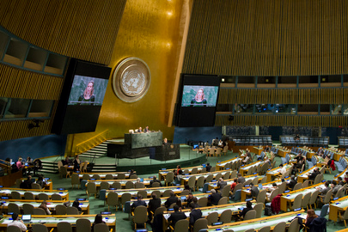
Sustainable Development GoALS …

Slide 3
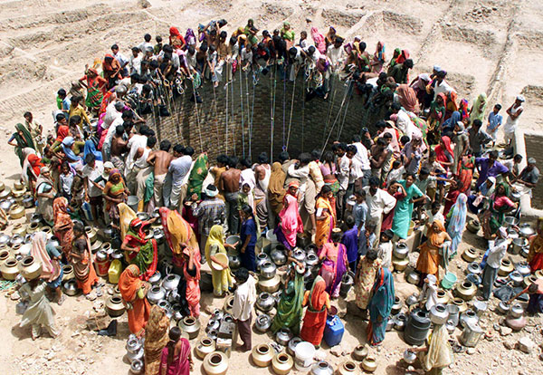
… AND NATIONAL DEVELOPMENT GOALS
Notes:
But the worst thing is: poor people hardest hit when scarcity occurs
Poor people are at the frontline, will be worst affected by growing scarcity, climate change
Poor people, for example, tend to rely disproportionately on natural assets like land, water, fisheries, or forestry—all of which will also be profoundly impacted by climate change.
95% of deaths from natural disasters in developing countries

Slide 4

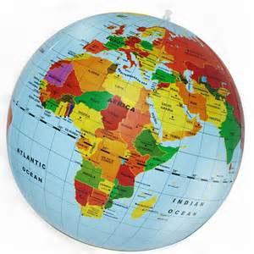
Un F4p, QCPR and Re-positioning

Slide 5
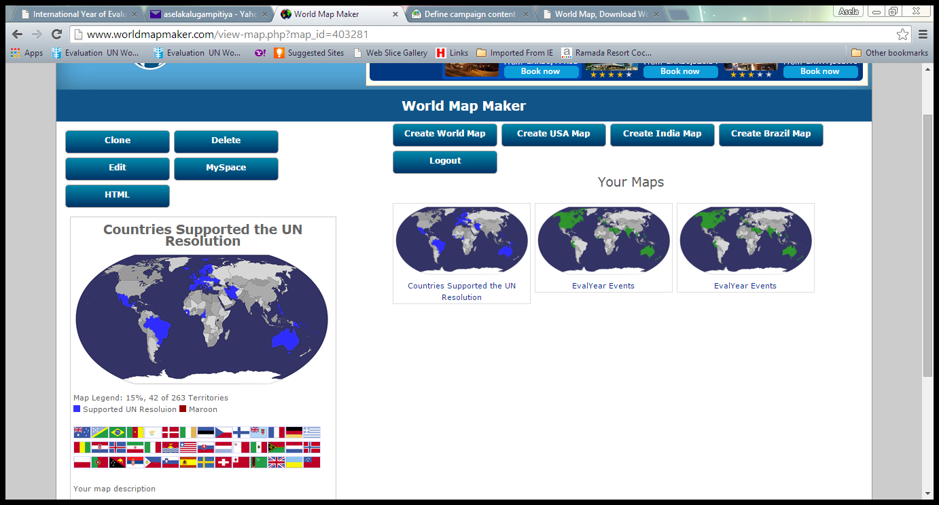
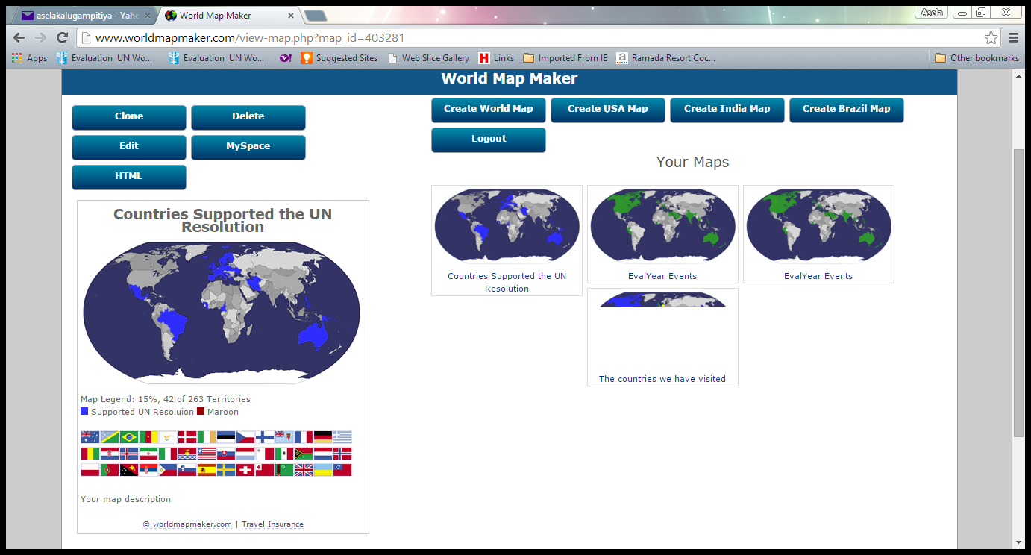
United Nations Resolution on Evaluation

Slide 6
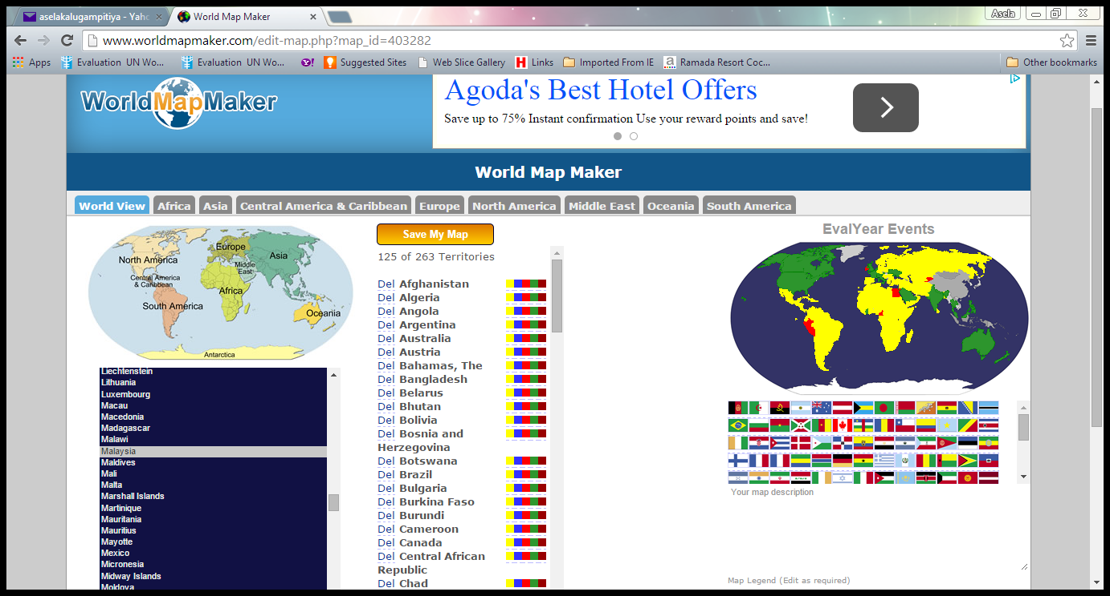
International Year of Evaluation

Slide 7

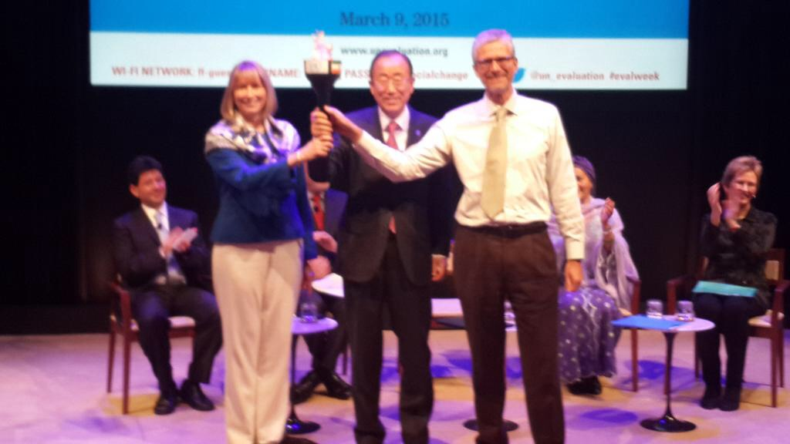

Torch moving

Slide 8
How to ensure UNEG is
Fit for the post-2015 world?

Slide 9
An enhanced UNEG for post-2015
Consolidate and Enhance
Diversity is our richness

Slide 10
Consolidate
  Norms and Standards
  Peer Review
  Professionalization
  Use of evaluation

Slide 11
Enhance
  UNEG contribution to SDG:
  Advocacy to integrate Evaluation in SDG
  Evaluability
  Provide evidence through systemic review
  NECD through partnership
  ISWE

Slide 12
Diversity is our richness
  UNEG must be relevant to all its members:
    from the smallest to the biggest UN entity;
    from those based in NY to those based in Europe, Africa and Asia;
    from those focusing on development to those focusing on humanitarian and normative work
    From those agencies with only a central evaluation function to those with a decentralized one

Slide 13
Each of us is UNEG
    Take each opportunity to speak of UNEG with your Board; your senior management; your staff; your colleagues
    When in external event, present you as an evaluators from your agency as well as a UNEG Member
    Include UNEG logo in your own electronic signature
    Be proactive.
      Get involved in the SO Committees.
      Take leadership in the area of work you have a professional and personal interest (Humanitarian- WFP- and Decentralized - UNFPA)
    Be innovative and take initiative:
      UNW Board expanded to UNDP/UNICEF/UNFPA to present UNEG work
      Rome-based UNEG members

Slide 14

UNEG fit for purpose:
an agent of change for the world we want

