Slide 1
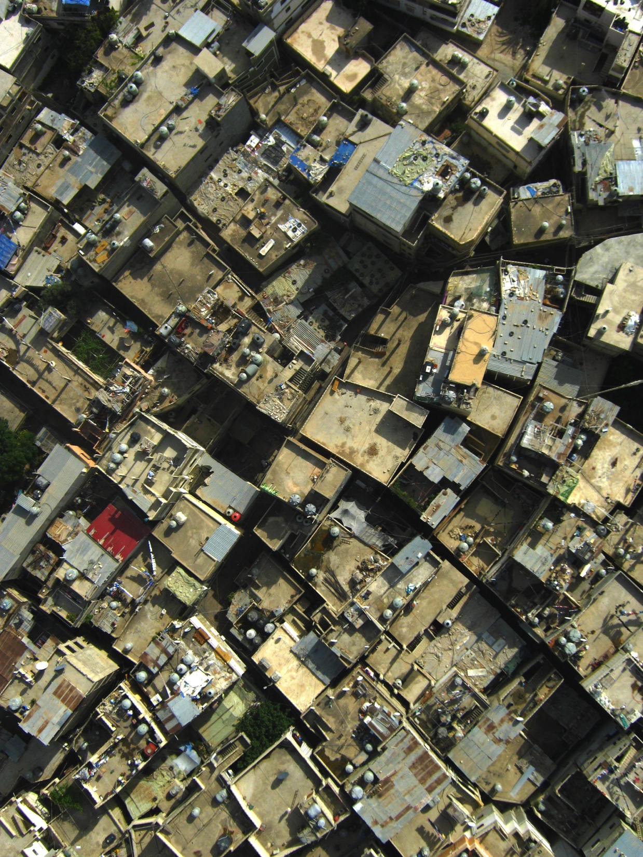
Balloon Mapping: Humanitarian Evaluation Methods
Claudia Martinez Mansell

Slide 2
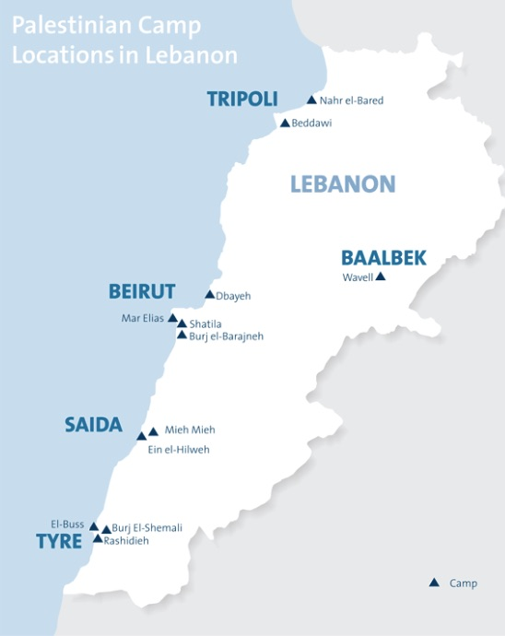

Slide 3
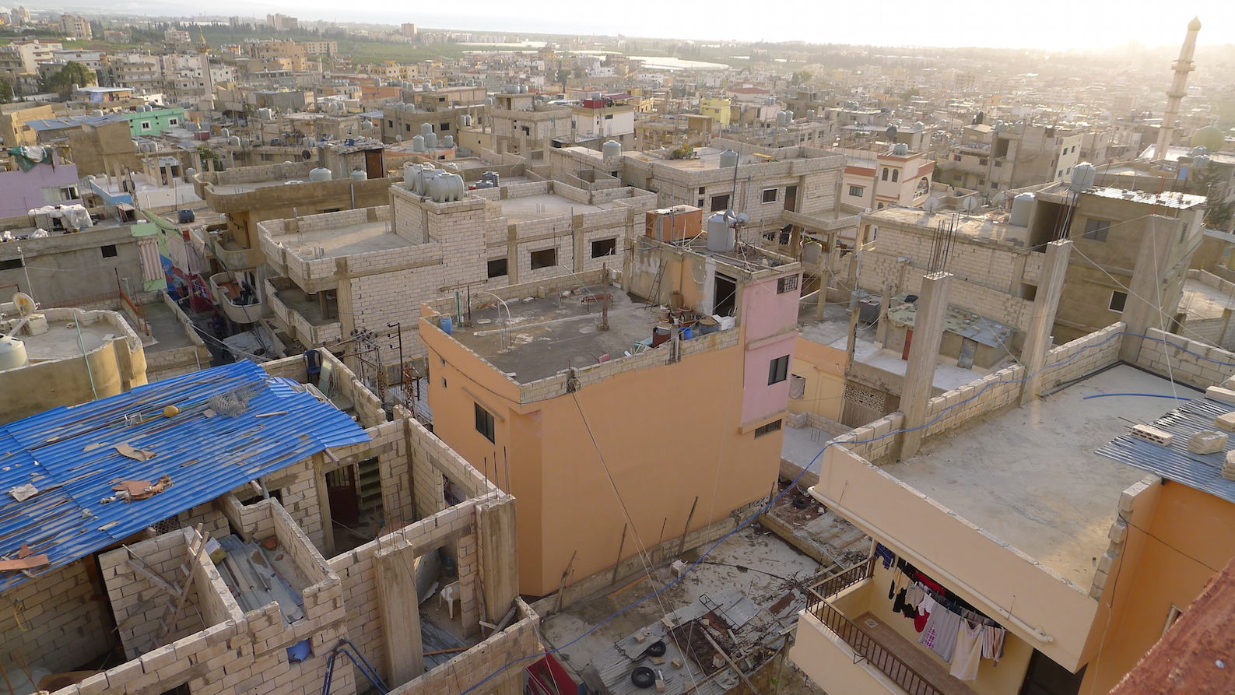
Bourj Al Shamali refugee camp

Slide 4
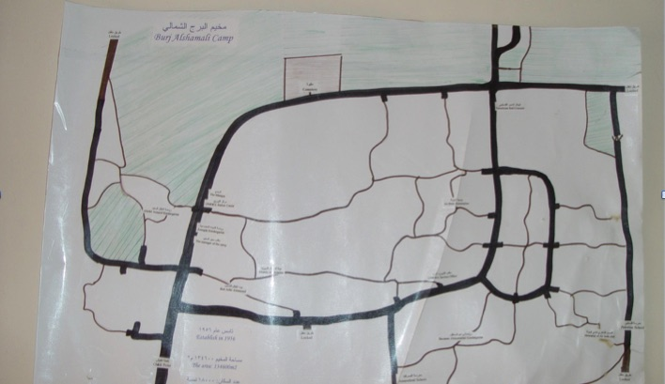
Map from Local Committee in Bourj Al Shamali

Slide 5
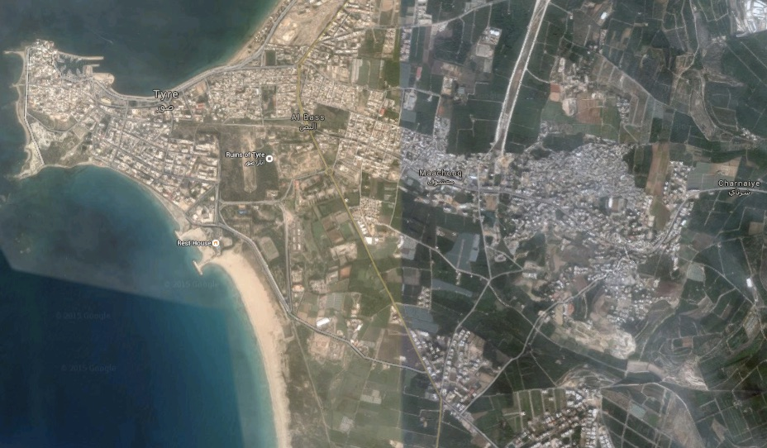

Slide 6
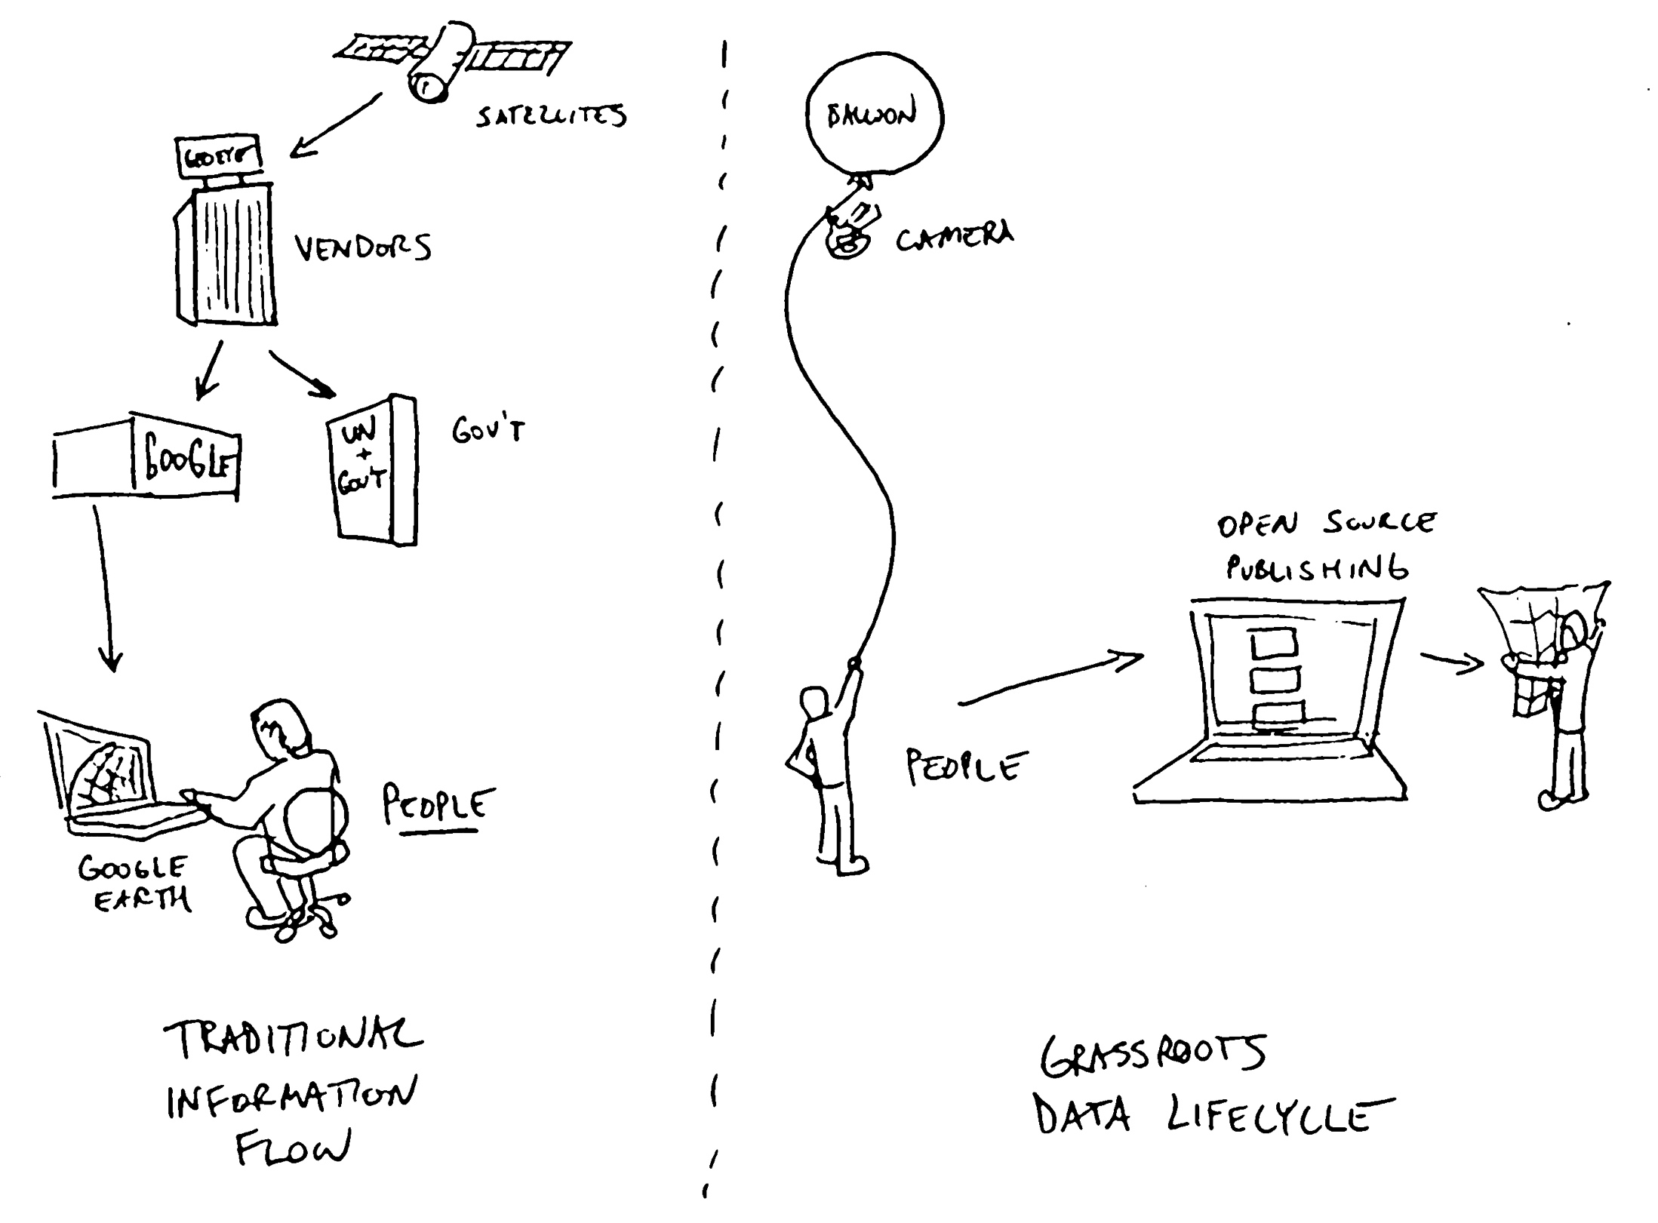
Drawings by Jeff Warren, Public Lab

Slide 7
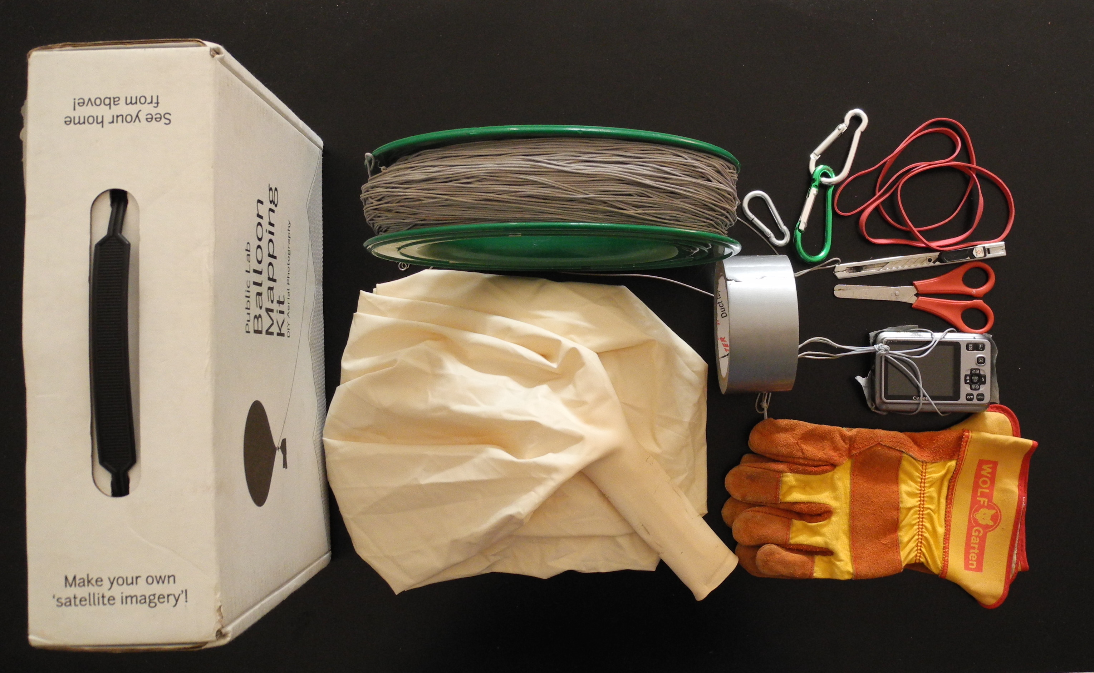
Balloon Mapping Kit
Photo by Hagit Keysar
Balloon Mapping toolkit - PublicLab.org

Slide 8
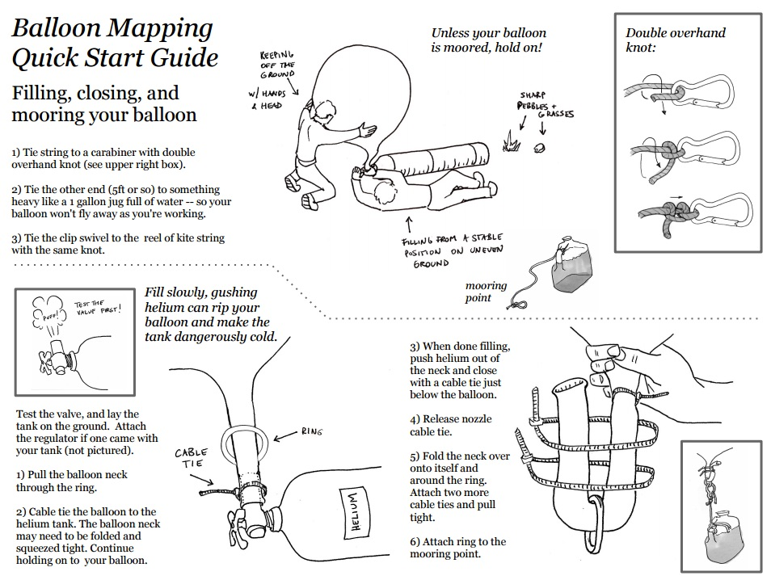
Balloon mapping instructions by Public Lab

Slide 9
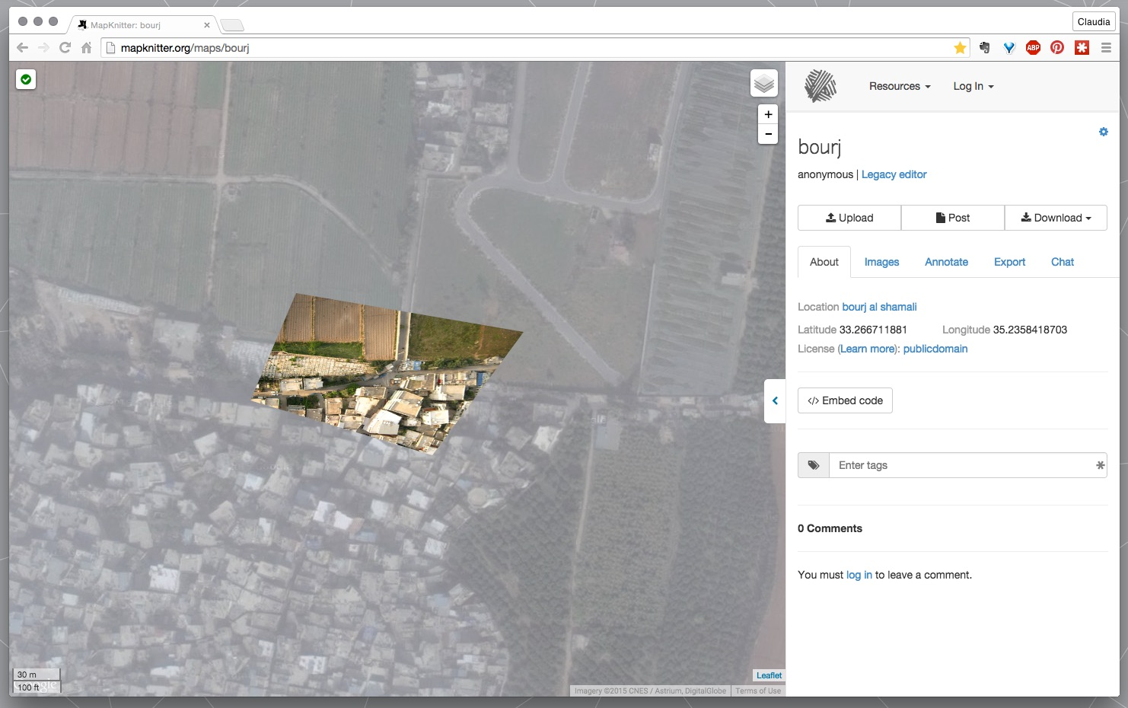
Public Lab’s Mapknitter Programme

Slide 10
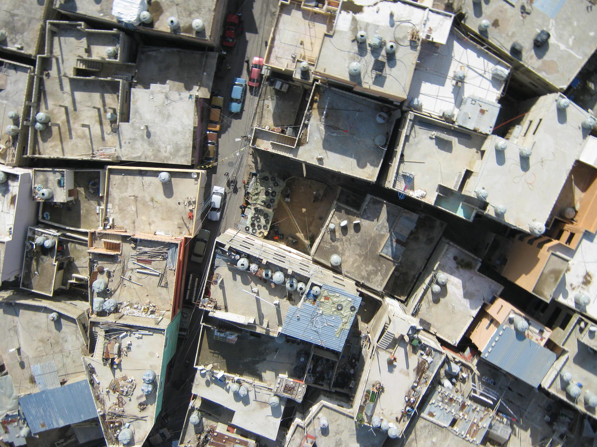
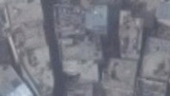
Image resolution:
Balloon mapping
Google imagery

Slide 11
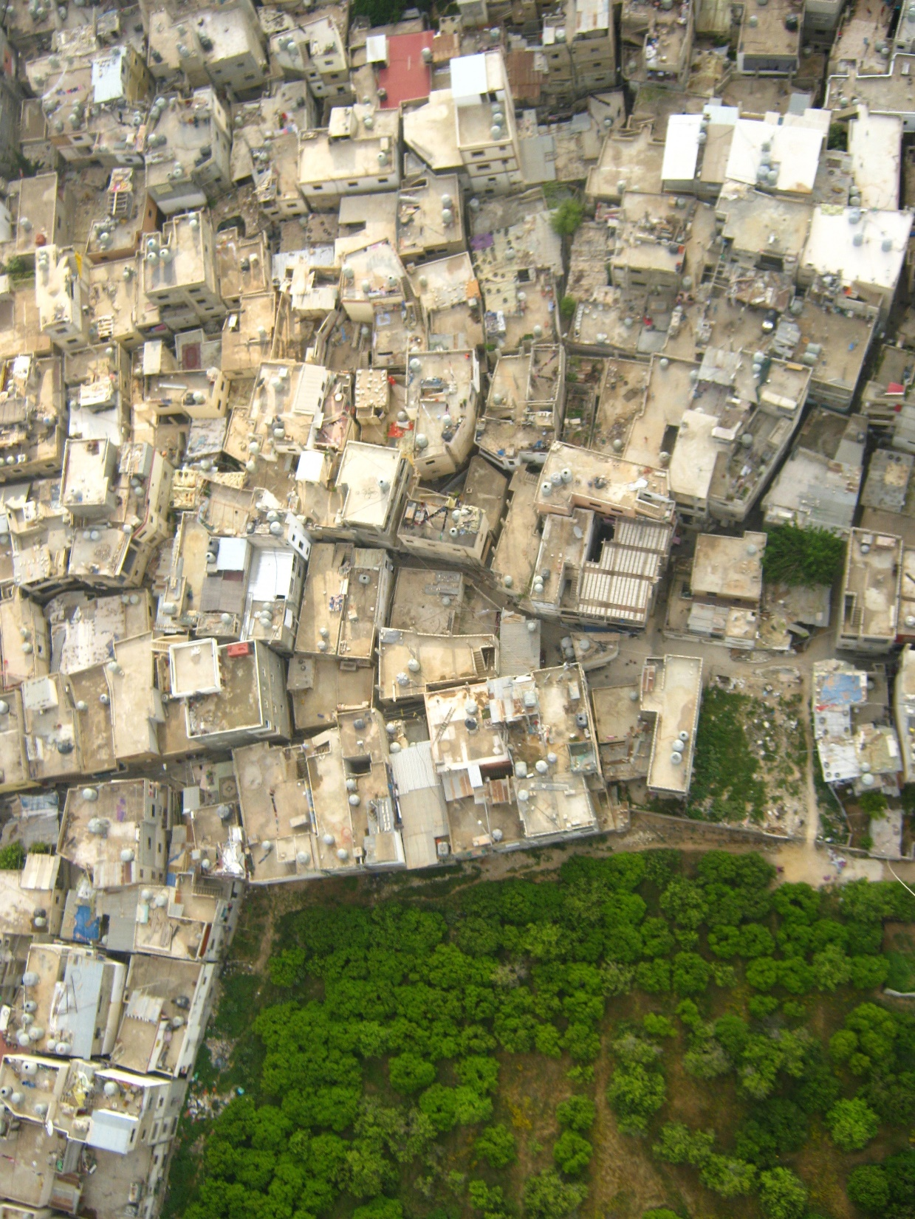
Lesson 1:
Make sure helium is available.
If not use kites.

Slide 12
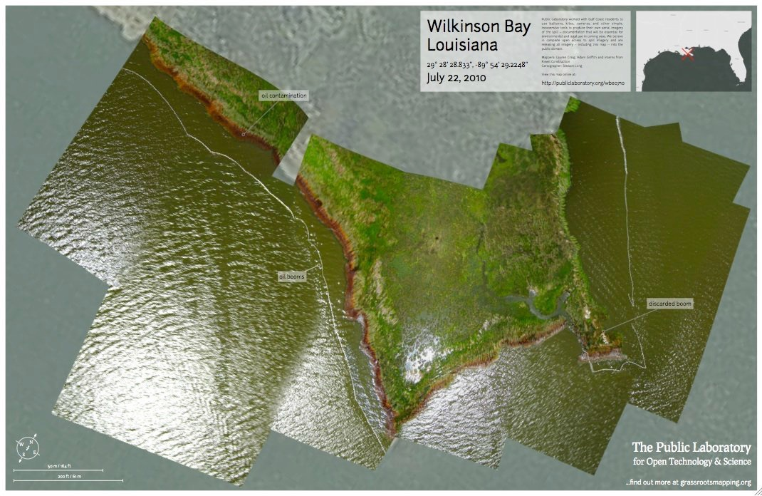
Lesson 2: Best use is when imagery is not available or you need before / after imagery

Slide 13
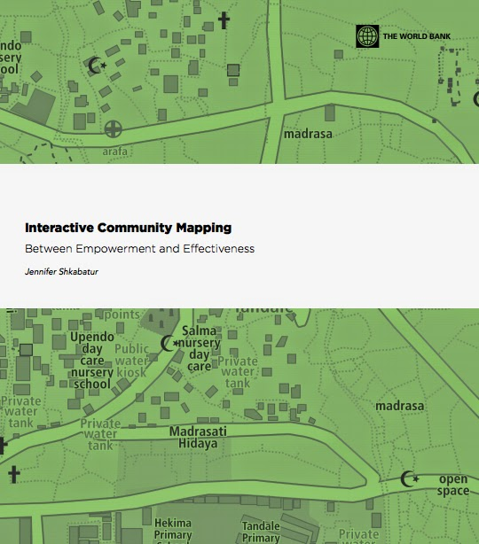
Lesson 3:
Know what you want to map & tools available
World Bank Publication
March 2014

Slide 14
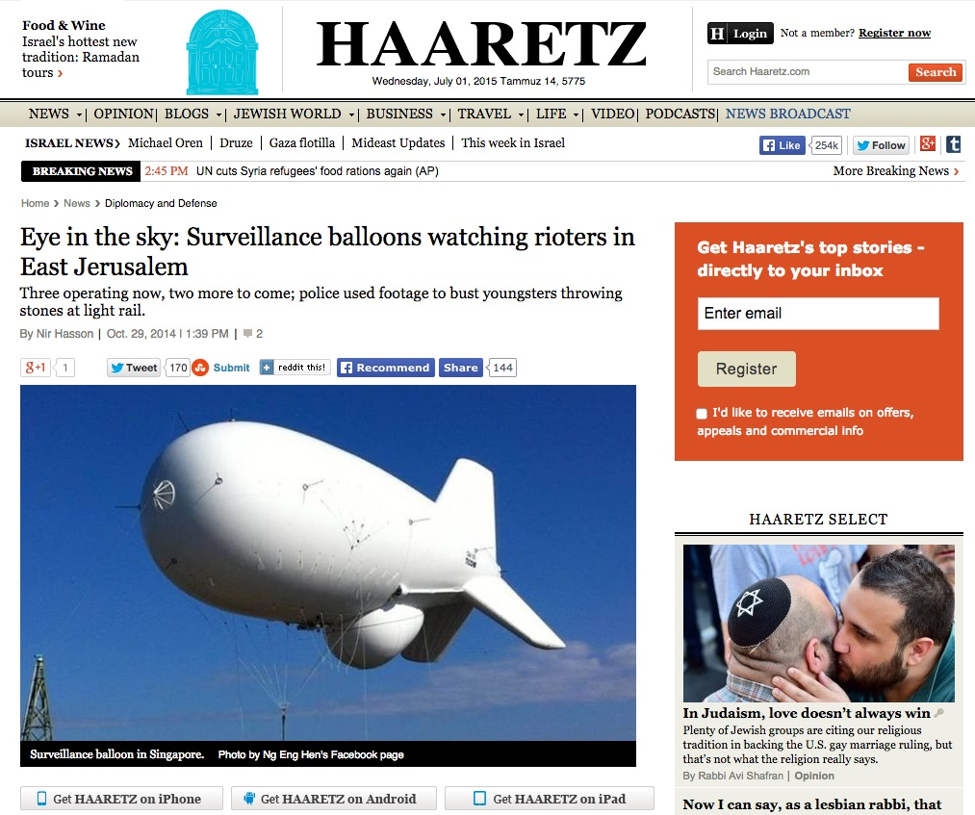
Lesson 4:
Work with communities.
Tools and maps carry different meanings for different stakeholders.

Slide 15
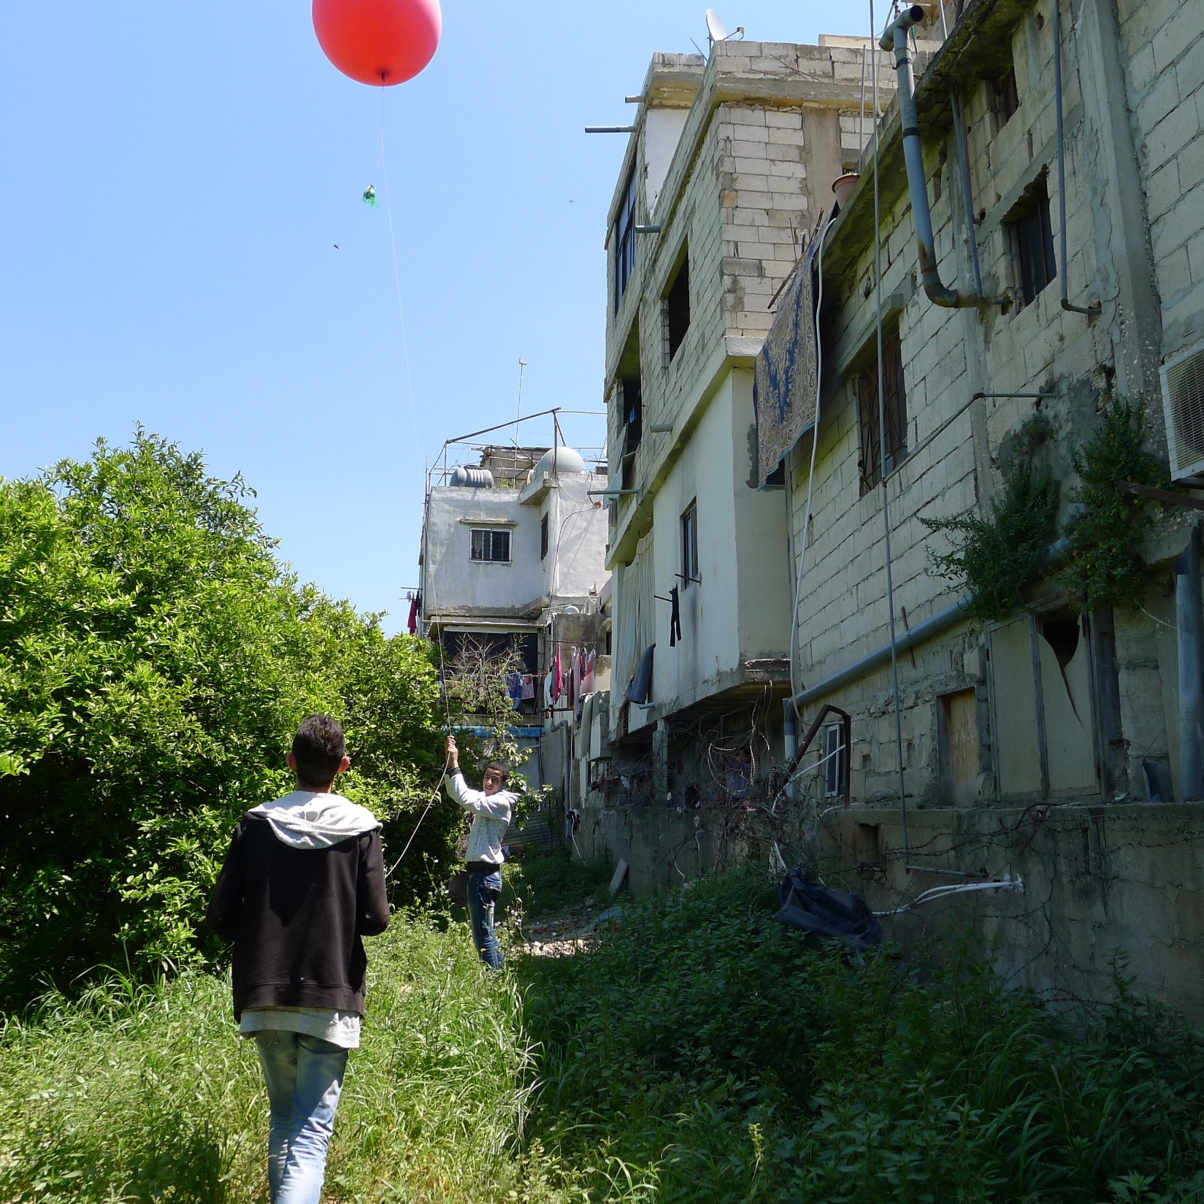
Lesson 5:
Low tech lowers barriers to participation

Slide 16
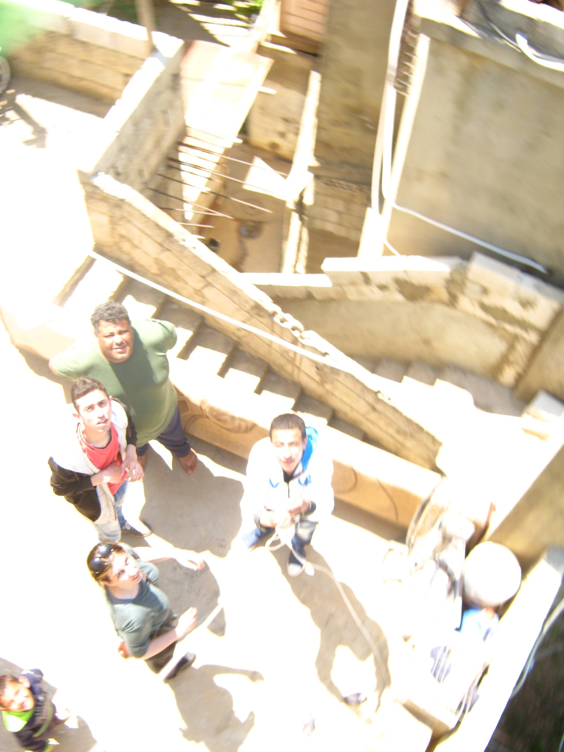
Lesson 6:
The mapper is in the map

Slide 17
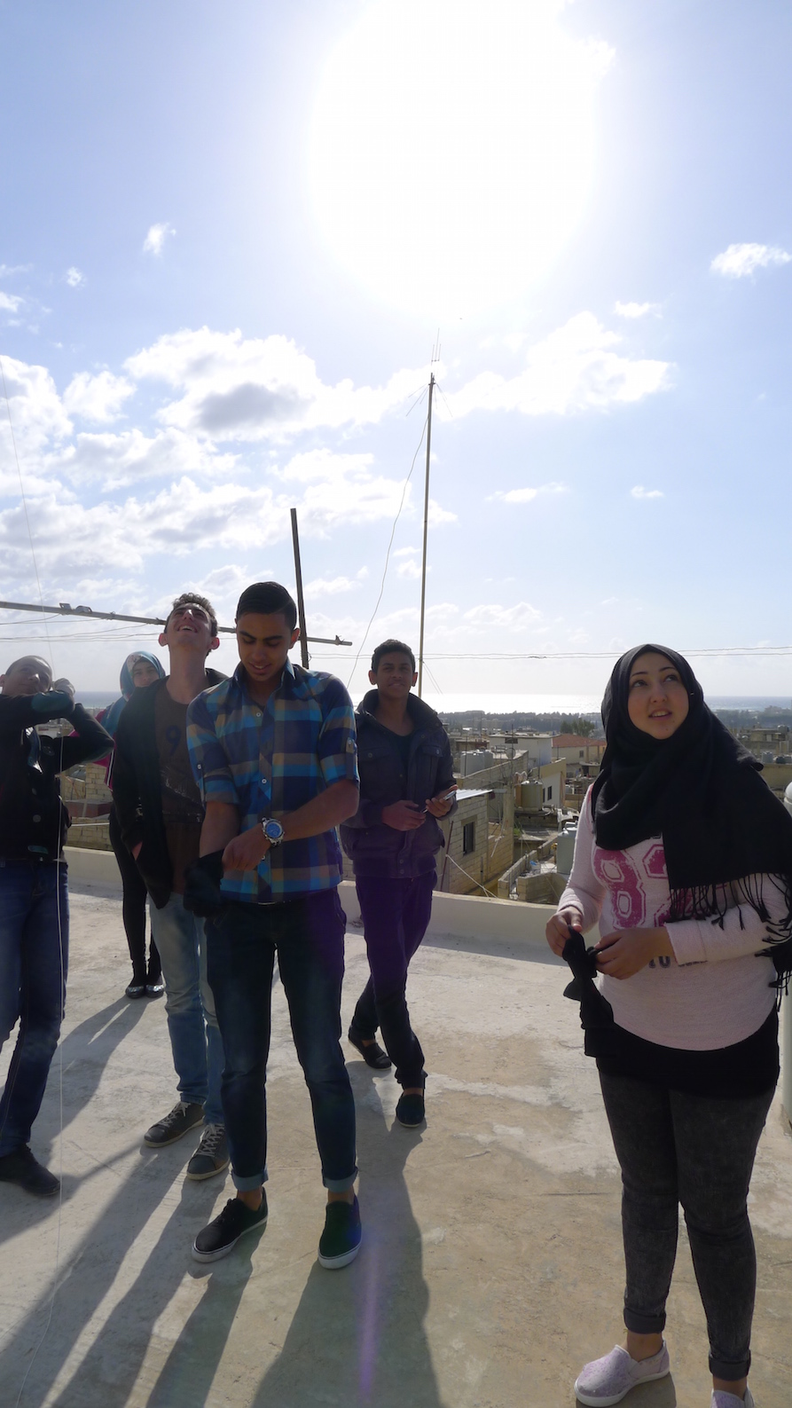


Slide 18

Thank you
Claudia Martinez Mansell clauds@gmail.com

